Slide 1
Identifiability and Indistinguishability of Linear Compartmental Models
Nikki Meshkat
Santa Clara University
San Jose State University Colloquium
March 15, 2023

Slide 2
Outline
What is structural identifiability?
What to do with an unidentifiable model?
Can identifiability ever break down?
What is indistinguishability?

Slide 3

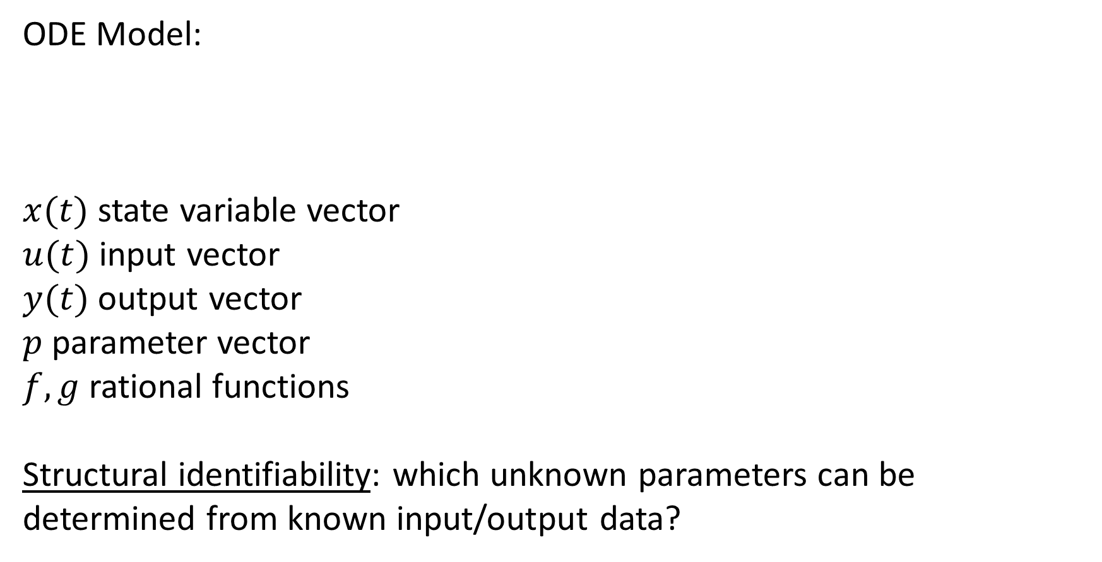
Structural Identifiability
ODE Model:
$x(t)$ state variable vector
$u(t)$ input vector
$y(t)$ output vector
$p$ parameter vector
$f, g$ rational functions
Structural identifiability: which unknown parameters can be determined from known input/output data?
  $$\dot{x}\left(t\right)=f\left(x\left(t\right),u\left(t\right),p\right)$$
  $$y\left(t\right)=g(x\left(t\right),p)$$

Slide 4

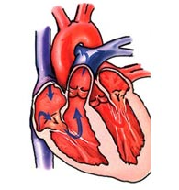
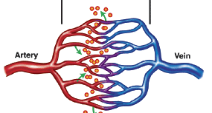
Motivation: biological models
Measured drug
concentration
Drug
input
Drug exchange
Loss from blood
Loss from organ
Notes:
Here example of simple bio model. In a lab, studying effects of a drug on the human body. Drug is admistered in the blood, “input”. Then drug is exchanged, leaves the system. Then after some time, the biologist measures the drug concentration in the blood, “output”. Important point: only know input/output, other arrows are unknown quantites, unknown parameters.

Slide 5






Example: Linear 2-Compartment Model
u₁
$$\text{y}\text{1}$$
x₁
$$a_{21}$$
x₂
$$a_{12}$$
$$a_{01}$$
$$a_{02}$$
$${\dot{x}}_{1}=−\left(a_{01}+a_{21}\right)x_{1}+a_{12}x_{2}+u_{1}$$
$${\dot{x}}_{2}=a_{21}x_{1}−(a_{02}+a_{12})x_{2}$$
$$y_{1}=x_{1}$$
Notes:
I’m going to be talking about models just like this one, which are more generally called “linear compartment models”, so let me formally define them now.

Slide 6

Example: Linear 2-Compartment Model
u₁
$$\text{y}\text{1}$$
x₁
$$a_{21}$$
x₂
Can we determine parameters
$a_{01}, a_{02}, a_{12}, a_{21}$ from input-output data?
$$a_{12}$$
$$a_{01}$$
$$a_{02}$$
$${\dot{x}}_{1}=−\left(a_{01}+a_{21}\right)x_{1}+a_{12}x_{2}+u_{1}$$
$${\dot{x}}_{2}=a_{21}x_{1}−(a_{02}+a_{12})x_{2}$$
$$y_{1}=x_{1}$$
Notes:
I’m going to be talking about models just like this one, which are more generally called “linear compartment models”, so let me formally define them now.

Slide 7
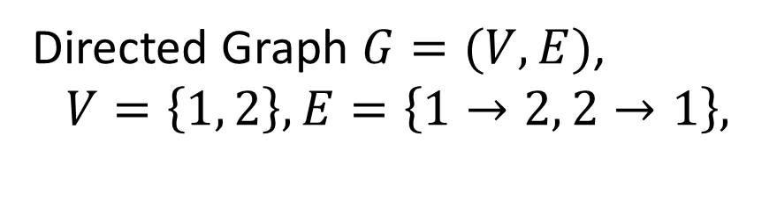
Example: Linear 2-Compartment Model
1
$$a_{21}$$
2
$$a_{12}$$
Directed Graph $G=(V,E)$,
$$V=\left\{1, 2\right\}, E=\left\{1→2, 2→1\right\},$$
Notes:
I’m going to be talking about models just like this one, which are more generally called “linear compartment models”, so let me formally define them now.

Slide 8
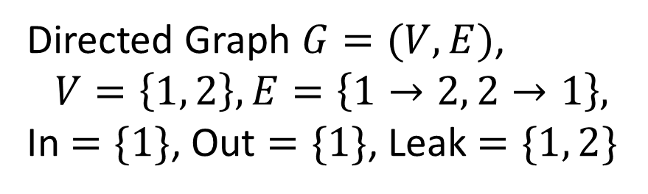
Example: Linear 2-Compartment Model
u₁
$$\text{y}\text{1}$$
x₁
$$a_{21}$$
x₂
$$a_{12}$$
$$a_{01}$$
$$a_{02}$$
Directed Graph $G=(V,E)$,
$$V=\left\{1, 2\right\}, E=\left\{1→2, 2→1\right\},$$
In $=\{1\}$, Out $=\{1\}$, Leak $=\{1, 2\}$
Notes:
I’m going to be talking about models just like this one, which are more generally called “linear compartment models”, so let me formally define them now.

Slide 9
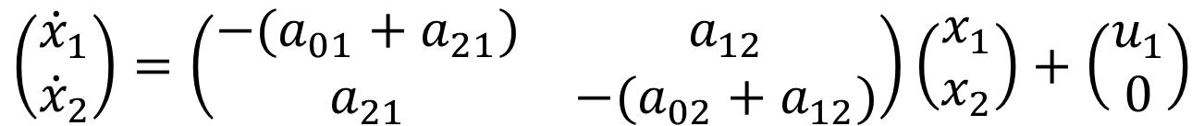
Example: Linear 2-Compartment Model
u₁
$$\text{y}\text{1}$$
x₁
$$a_{21}$$
x₂
$$a_{12}$$
$$a_{01}$$
$$a_{02}$$
$$\left(\begin{matrix}{\dot{x}}_{1} \\ {\dot{x}}_{2}\end{matrix}\right)=\left(\begin{matrix}−(a_{01}+a_{21}) & a_{12} \\ a_{21} & −(a_{02}+a_{12})\end{matrix}\right)\left(\begin{matrix}x_{1} \\ x_{2}\end{matrix}\right)+\left(\begin{matrix}u_{1} \\ 0\end{matrix}\right)$$
$$y_{1}=x_{1}$$
Notes:
I’m going to be talking about models just like this one, which are more generally called “linear compartment models”, so let me formally define them now.

Slide 10
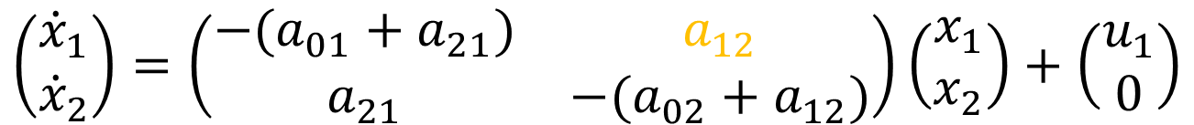

Example: Linear 2-Compartment Model
u₁
$$\text{y}\text{1}$$
x₁
$$a_{21}$$
x₂
$$a_{12}$$
$$a_{01}$$
$$a_{02}$$
$$\left(\begin{matrix}{\dot{x}}_{1} \\ {\dot{x}}_{2}\end{matrix}\right)=\left(\begin{matrix}−(a_{01}+a_{21}) & a_{12} \\ a_{21} & −(a_{02}+a_{12})\end{matrix}\right)\left(\begin{matrix}x_{1} \\ x_{2}\end{matrix}\right)+\left(\begin{matrix}u_{1} \\ 0\end{matrix}\right)$$
$$y_{1}=x_{1}$$
Notes:
I’m going to be talking about models just like this one, which are more generally called “linear compartment models”, so let me formally define them now.

Slide 11
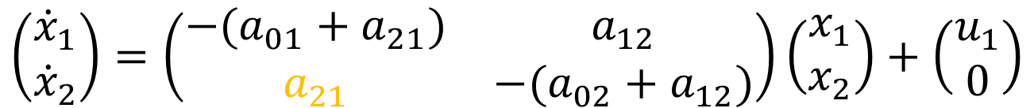

Example: Linear 2-Compartment Model
u₁
$$\text{y}\text{1}$$
x₁
$$a_{21}$$
x₂
$$a_{12}$$
$$a_{01}$$
$$a_{02}$$
$$\left(\begin{matrix}{\dot{x}}_{1} \\ {\dot{x}}_{2}\end{matrix}\right)=\left(\begin{matrix}−(a_{01}+a_{21}) & a_{12} \\ a_{21} & −(a_{02}+a_{12})\end{matrix}\right)\left(\begin{matrix}x_{1} \\ x_{2}\end{matrix}\right)+\left(\begin{matrix}u_{1} \\ 0\end{matrix}\right)$$
$$y_{1}=x_{1}$$
Notes:
I’m going to be talking about models just like this one, which are more generally called “linear compartment models”, so let me formally define them now.

Slide 12


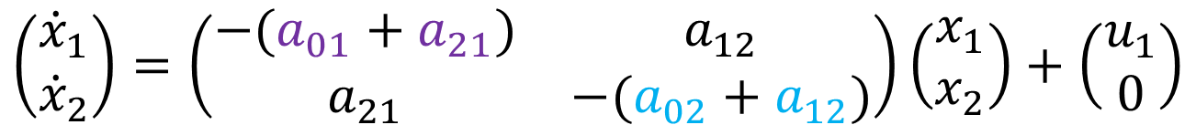


Example: Linear 2-Compartment Model
u₁
$$\text{y}\text{1}$$
x₁
$$a_{21}$$
x₂
$$a_{12}$$
$$a_{01}$$
$$a_{02}$$
$$\left(\begin{matrix}{\dot{x}}_{1} \\ {\dot{x}}_{2}\end{matrix}\right)=\left(\begin{matrix}−(a_{01}+a_{21}) & a_{12} \\ a_{21} & −(a_{02}+a_{12})\end{matrix}\right)\left(\begin{matrix}x_{1} \\ x_{2}\end{matrix}\right)+\left(\begin{matrix}u_{1} \\ 0\end{matrix}\right)$$
$$y_{1}=x_{1}$$
Notes:
I’m going to be talking about models just like this one, which are more generally called “linear compartment models”, so let me formally define them now.

Slide 13



How to test identifiability – Diff. alg. approach
Have ODE model:
Have known variables: $u_{1}, y_{1}$
$${\dot{x}}_{1}=−\left(a_{01}+a_{21}\right)x_{1}+a_{12}x_{2}+u_{1}$$
$${\dot{x}}_{2}=a_{21}x_{1}−(a_{02}+a_{12}) x_{2}$$
$$y_{1}=x_{1}$$
[Ollivier 1990, Ljung-Glad 1994]

Slide 14

How to test identifiability – Diff. alg. approach
Have ODE model:
Have known variables: $u_{1}, y_{1}$
Assuming perfect data, we know ${\dot{u}}_{1},{\dot{y}}_{1}, {\ddot{u}}_{1}, {\ddot{y}}_{1},$…
$${\dot{x}}_{1}=−\left(a_{01}+a_{21}\right)x_{1}+a_{12}x_{2}+u_{1}$$
$${\dot{x}}_{2}=a_{21}x_{1}−(a_{02}+a_{12}) x_{2}$$
$$y_{1}=x_{1}$$
[Ollivier 1990, Ljung-Glad 1994]

Slide 15



How to test identifiability – Diff. alg. approach
Have ODE model:
Have known variables: $u_{1}, y_{1}$
Assuming perfect data, we know ${\dot{u}}_{1},{\dot{y}}_{1}, {\ddot{u}}_{1}, {\ddot{y}}_{1},$…
Can we eliminate unknown variables $x_{1}, {\dot{x}}_{1},x_{2}, {\dot{x}}_{2}$?
$${\dot{x}}_{1}=−\left(a_{01}+a_{21}\right)x_{1}+a_{12}x_{2}+u_{1}$$
$${\dot{x}}_{2}=a_{21}x_{1}−(a_{02}+a_{12}) x_{2}$$
$$y_{1}=x_{1}$$
[Ollivier 1990, Ljung-Glad 1994]

Slide 16
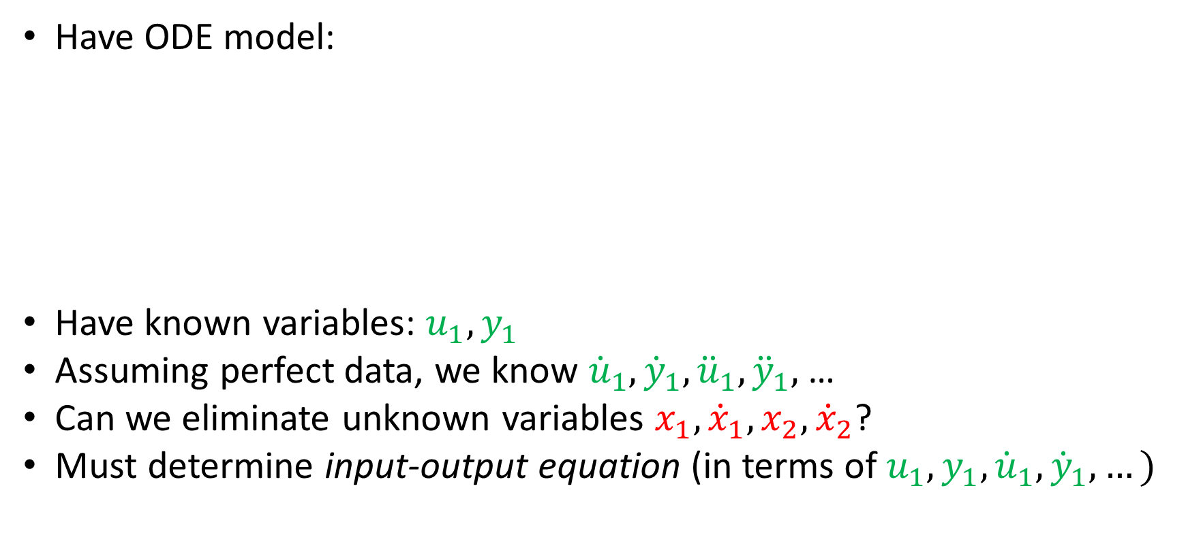
How to test identifiability – Diff. alg. approach
Have ODE model:
Have known variables: $u_{1}, y_{1}$
Assuming perfect data, we know ${\dot{u}}_{1},{\dot{y}}_{1}, {\ddot{u}}_{1}, {\ddot{y}}_{1},$…
Can we eliminate unknown variables $x_{1}, {\dot{x}}_{1},x_{2}, {\dot{x}}_{2}$?
Must determine input-output equation (in terms of $u_{1}, y_{1}, {\dot{u}}_{1},{\dot{y}}_{1},…)$
$${\dot{x}}_{1}=−\left(a_{01}+a_{21}\right)x_{1}+a_{12}x_{2}+u_{1}$$
$${\dot{x}}_{2}=a_{21}x_{1}−(a_{02}+a_{12}) x_{2}$$
$$y_{1}=x_{1}$$
[Ollivier 1990, Ljung-Glad 1994]

Slide 17






Determine input-output equations
Use differential elimination:
$${\dot{x}}_{1}=−\left(a_{01}+a_{21}\right)x_{1}+a_{12}x_{2}+u_{1}$$
$${\dot{y}}_{1}=−\left(a_{01}+a_{21}\right)y_{1}+a_{12}x_{2}+u_{1}$$
Sub for $x_{1},{\dot{x}}_{1}$
$${\dot{x}}_{2}=a_{21}x_{1}−(a_{02}+a_{12}) x_{2}$$
$${\dot{x}}_{2}=a_{21}y_{1}−(a_{02}+a_{12}) x_{2}$$
$$y_{1}=x_{1}$$
$$y_{1}=x_{1}$$

Slide 18


Determine input-output equations
Use differential elimination:
$${\dot{x}}_{1}=−\left(a_{01}+a_{21}\right)x_{1}+a_{12}x_{2}+u_{1}$$
$${\dot{y}}_{1}=−\left(a_{01}+a_{21}\right)y_{1}+a_{12}x_{2}+u_{1}$$
Sub for $x_{1},{\dot{x}}_{1}$
$${\dot{x}}_{2}=a_{21}x_{1}−(a_{02}+a_{12}) x_{2}$$
$${\dot{x}}_{2}=a_{21}y_{1}−(a_{02}+a_{12}) x_{2}$$
$$y_{1}=x_{1}$$
$$y_{1}=x_{1}$$

Slide 19





Determine input-output equations
Use differential elimination:
$${\dot{x}}_{1}=−\left(a_{01}+a_{21}\right)x_{1}+a_{12}x_{2}+u_{1}$$
$${\dot{y}}_{1}=−\left(a_{01}+a_{21}\right)y_{1}+a_{12}x_{2}+u_{1}$$
Sub for $x_{1},{\dot{x}}_{1}$
$${\dot{x}}_{2}=a_{21}x_{1}−(a_{02}+a_{12}) x_{2}$$
$${\dot{x}}_{2}=a_{21}y_{1}−(a_{02}+a_{12}) x_{2}$$
$$y_{1}=x_{1}$$
$$y_{1}=x_{1}$$
$$x_{2}=({\dot{y}}_{1}+\left(a_{01}+a_{21}\right)y_{1}−u_{1})/a_{12}$$
Solve for $x_{2}$
$${\dot{x}}_{2}=a_{21}y_{1}−(a_{02}+a_{12}) x_{2}$$
$$y_{1}=x_{1}$$

Slide 20


Determine input-output equations
Use differential elimination:
$${\dot{x}}_{1}=−\left(a_{01}+a_{21}\right)x_{1}+a_{12}x_{2}+u_{1}$$
$${\dot{y}}_{1}=−\left(a_{01}+a_{21}\right)y_{1}+a_{12}x_{2}+u_{1}$$
Sub for $x_{1},{\dot{x}}_{1}$
$${\dot{x}}_{2}=a_{21}x_{1}−(a_{02}+a_{12}) x_{2}$$
$${\dot{x}}_{2}=a_{21}y_{1}−(a_{02}+a_{12}) x_{2}$$
$$y_{1}=x_{1}$$
$$y_{1}=x_{1}$$
$$x_{2}=({\dot{y}}_{1}+\left(a_{01}+a_{21}\right)y_{1}−u_{1})/a_{12}$$
Solve for $x_{2}$
Diff. $x_{2}$
$${\dot{x}}_{2}=a_{21}y_{1}−(a_{02}+a_{12}) x_{2}$$
$${\dot{x}}_{2}=({\ddot{y}}_{1}+\left(a_{01}+a_{21}\right){\dot{y}}_{1}−{\dot{u}}_{1})/a_{12}$$
$$y_{1}=x_{1}$$

Slide 21

Determine input-output equations
Use differential elimination:
$${\dot{x}}_{1}=−\left(a_{01}+a_{21}\right)x_{1}+a_{12}x_{2}+u_{1}$$
$${\dot{y}}_{1}=−\left(a_{01}+a_{21}\right)y_{1}+a_{12}x_{2}+u_{1}$$
Sub for $x_{1},{\dot{x}}_{1}$
$${\dot{x}}_{2}=a_{21}x_{1}−(a_{02}+a_{12}) x_{2}$$
$${\dot{x}}_{2}=a_{21}y_{1}−(a_{02}+a_{12}) x_{2}$$
$$y_{1}=x_{1}$$
$$y_{1}=x_{1}$$
$$x_{2}=({\dot{y}}_{1}+\left(a_{01}+a_{21}\right)y_{1}−u_{1})/a_{12}$$
Solve for $x_{2}$
Diff. $x_{2}$
$${\dot{x}}_{2}=a_{21}y_{1}−(a_{02}+a_{12}) x_{2}$$
$${\dot{x}}_{2}=({\ddot{y}}_{1}+\left(a_{01}+a_{21}\right){\dot{y}}_{1}−{\dot{u}}_{1})/a_{12}$$
$$y_{1}=x_{1}$$

Slide 22



Determine input-output equations
Use differential elimination:
$${\dot{x}}_{1}=−\left(a_{01}+a_{21}\right)x_{1}+a_{12}x_{2}+u_{1}$$
$${\dot{y}}_{1}=−\left(a_{01}+a_{21}\right)y_{1}+a_{12}x_{2}+u_{1}$$
Sub for $x_{1},{\dot{x}}_{1}$
$${\dot{x}}_{2}=a_{21}x_{1}−(a_{02}+a_{12}) x_{2}$$
$${\dot{x}}_{2}=a_{21}y_{1}−(a_{02}+a_{12}) x_{2}$$
$$y_{1}=x_{1}$$
$$y_{1}=x_{1}$$
$$x_{2}=({\dot{y}}_{1}+\left(a_{01}+a_{21}\right)y_{1}−u_{1})/a_{12}$$
Solve for $x_{2}$
Diff. $x_{2}$
$${\dot{x}}_{2}=a_{21}y_{1}−(a_{02}+a_{12}) x_{2}$$
$${\dot{x}}_{2}=({\ddot{y}}_{1}+\left(a_{01}+a_{21}\right){\dot{y}}_{1}−{\dot{u}}_{1})/a_{12}$$
$$y_{1}=x_{1}$$
Sub for $x_{2}, {\dot{x}}_{2}$
$${\ddot{y}}_{1}+\left(a_{01}+a_{02}+a_{12}+a_{21}\right){\dot{y}}_{1}+(a_{01}a_{12}+a_{02}a_{21}+a_{01}a_{02})y_{1}={\dot{u}}_{1}+(a_{02}+a_{12})u_{1}$$

Slide 23

Determine input-output equations (slick way)
Have system $\dot{x}=Ax+u$, $y_{1}=x_{1}$

Slide 24

Determine input-output equations (slick way)
Have system $\dot{x}=Ax+u$, $y_{1}=x_{1}$
Rewrite system as $\left(∂I−A\right)x=u$, where $∂=d/dt$

Slide 25

Determine input-output equations (slick way)
Have system $\dot{x}=Ax+u$, $y_{1}=x_{1}$
Rewrite system as $\left(∂I−A\right)x=u$, where $∂=d/dt$
Let $A=\left(\begin{matrix}−a_{01}−a_{21} & a_{12} \\ a_{21} & −a_{02}−a_{12}\end{matrix}\right)$, $A_{11}=(−a_{02}−a_{12})$

Slide 26
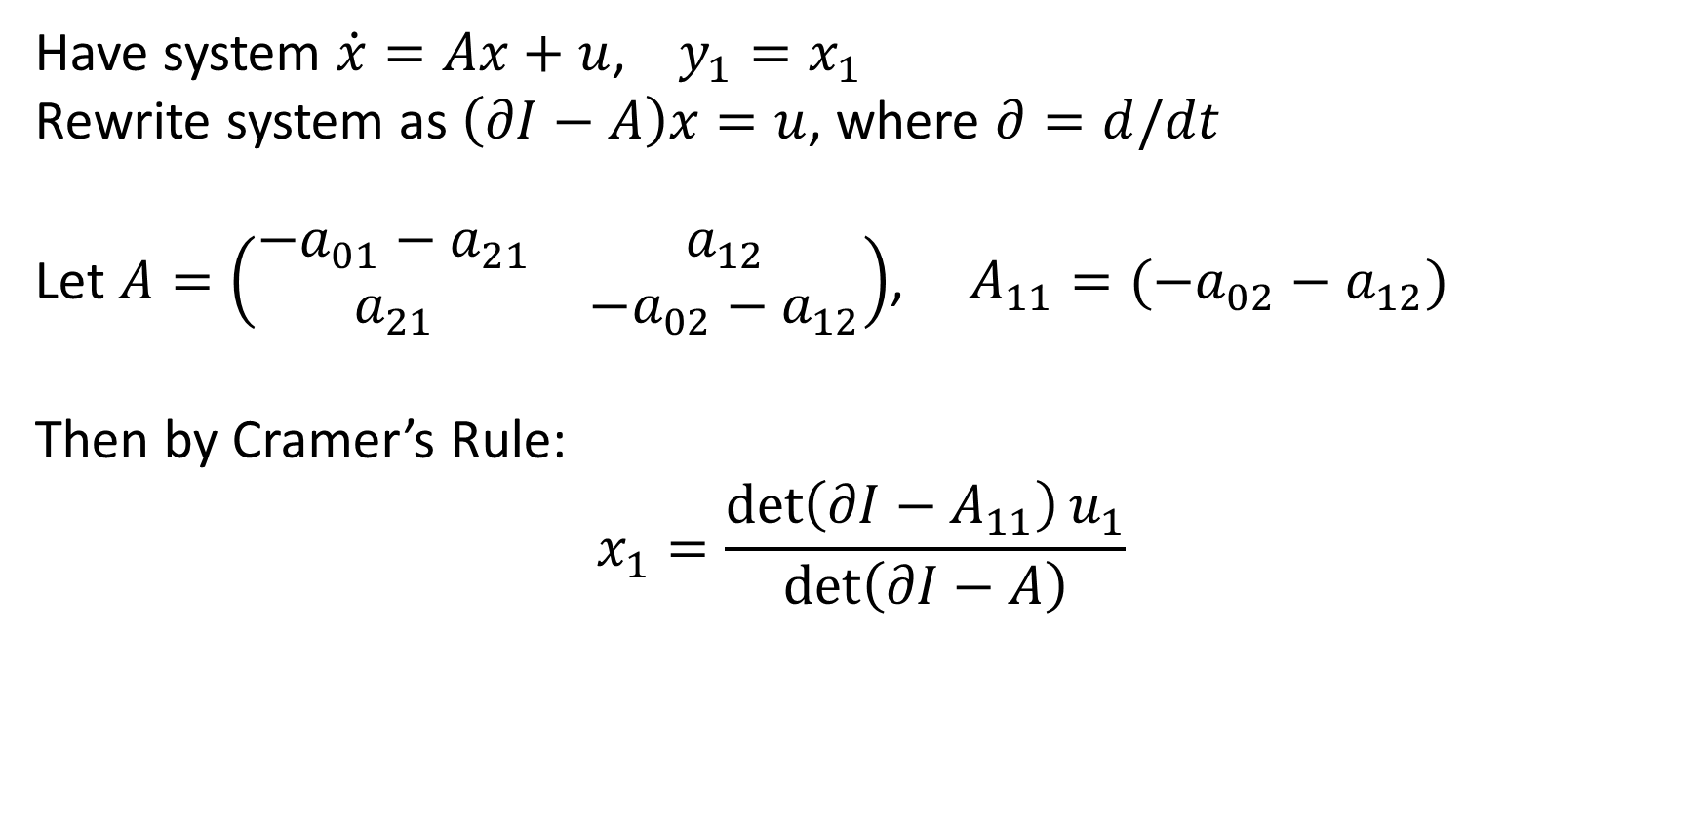
Determine input-output equations (slick way)
Have system $\dot{x}=Ax+u$, $y_{1}=x_{1}$
Rewrite system as $\left(∂I−A\right)x=u$, where $∂=d/dt$
Let $A=\left(\begin{matrix}−a_{01}−a_{21} & a_{12} \\ a_{21} & −a_{02}−a_{12}\end{matrix}\right)$, $A_{11}=(−a_{02}−a_{12})$
Then by Cramer’s Rule:
$$x_{1}=\frac{\det\left(∂I−A_{11}\right)u_{1}}{\det\left(∂I−A\right)}$$

Slide 27


Determine input-output equations (slick way)
Have system $\dot{x}=Ax+u$, $y_{1}=x_{1}$
Rewrite system as $\left(∂I−A\right)x=u$, where $∂=d/dt$
Let $A=\left(\begin{matrix}−a_{01}−a_{21} & a_{12} \\ a_{21} & −a_{02}−a_{12}\end{matrix}\right)$, $A_{11}=(−a_{02}−a_{12})$
Then by Cramer’s Rule:
$$x_{1}=\frac{\det\left(∂I−A_{11}\right)u_{1}}{\det\left(∂I−A\right)}$$
$$\frac{\det\left(\begin{matrix}u_{1} & −a_{12} \\ 0 & ∂+a_{02}+a_{12}\end{matrix}\right)}{\det\left(\begin{matrix}∂+a_{01}+a_{21} & −a_{12} \\ −a_{21} & ∂+a_{02}+a_{12}\end{matrix}\right)}$$
$$=$$

Slide 28
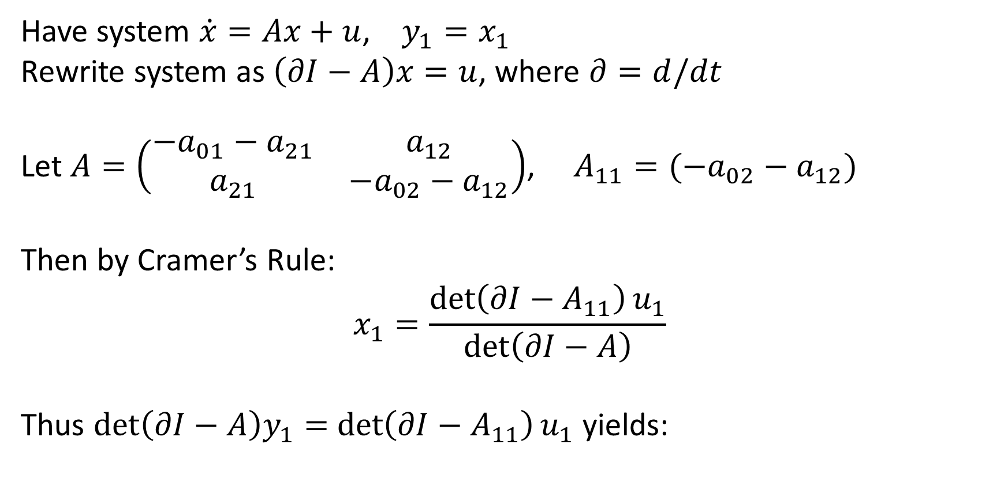
Determine input-output equations (slick way)
Have system $\dot{x}=Ax+u$, $y_{1}=x_{1}$
Rewrite system as $\left(∂I−A\right)x=u$, where $∂=d/dt$
Let $A=\left(\begin{matrix}−a_{01}−a_{21} & a_{12} \\ a_{21} & −a_{02}−a_{12}\end{matrix}\right)$, $A_{11}=(−a_{02}−a_{12})$
Then by Cramer’s Rule:
$$x_{1}=\frac{\det\left(∂I−A_{11}\right)u_{1}}{\det\left(∂I−A\right)}$$
Thus $\det\left(∂I−A\right)y_{1}=$ $\det\left(∂I−A_{11}\right)u_{1}$ yields:
$${\ddot{y}}_{1}+\left(a_{01}+a_{02}+a_{12}+a_{21}\right){\dot{y}}_{1}+(a_{01}a_{12}+a_{02}a_{21}+a_{01}a_{02})y_{1}={\dot{u}}_{1}+(a_{02}+a_{12})u_{1}$$

Slide 29
Obtain coefficient map
Assume we can uniquely determine coefficients from perfect data
$${\ddot{y}}_{1}+\left(a_{01}+a_{02}+a_{12}+a_{21}\right){\dot{y}}_{1}+(a_{01}a_{12}+a_{02}a_{21}+a_{01}a_{02})y_{1}={\dot{u}}_{1}+(a_{02}+a_{12})u_{1}$$

Slide 30
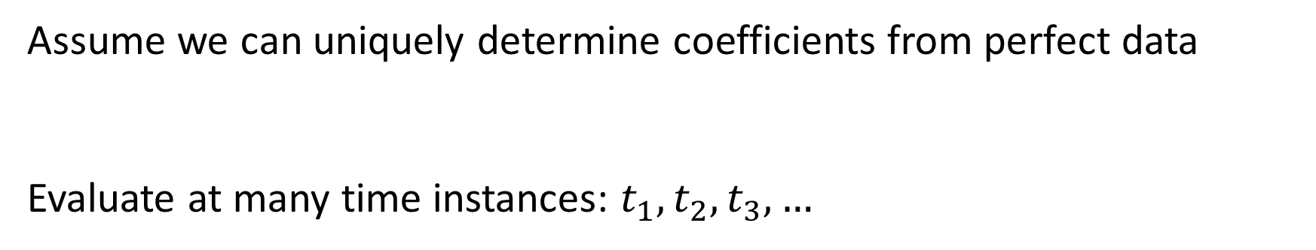
Obtain coefficient map
Assume we can uniquely determine coefficients from perfect data
Evaluate at many time instances: $t_{1}, t_{2}, t_{3},…$
$${\ddot{y}}_{1}+\left(a_{01}+a_{02}+a_{12}+a_{21}\right){\dot{y}}_{1}+(a_{01}a_{12}+a_{02}a_{21}+a_{01}a_{02})y_{1}={\dot{u}}_{1}+(a_{02}+a_{12})u_{1}$$
$${\ddot{y}}_{1}(t_{1})+\left(a_{01}+a_{02}+a_{12}+a_{21}\right){\dot{y}}_{1}(t_{1})+(a_{01}a_{12}+a_{02}a_{21}+a_{01}a_{02})y_{1}(t_{1})={\dot{u}}_{1}(t_{1})+(a_{02}+a_{12})u_{1}(t_{1})$$
$${\ddot{y}}_{1}(t_{2})+\left(a_{01}+a_{02}+a_{12}+a_{21}\right){\dot{y}}_{1}(t_{2})+(a_{01}a_{12}+a_{02}a_{21}+a_{01}a_{02})y_{1}(t_{2})={\dot{u}}_{1}(t_{2})+(a_{02}+a_{12})u_{1}(t_{2})$$
$$⋮$$
$${\ddot{y}}_{1}(t_{n})+\left(a_{01}+a_{02}+a_{12}+a_{21}\right){\dot{y}}_{1}(t_{n})+(a_{01}a_{12}+a_{02}a_{21}+a_{01}a_{02})y_{1}(t_{n})={\dot{u}}_{1}(t_{n})+(a_{02}+a_{12})u_{1}(t_{n})$$

Slide 31
Obtain coefficient map
Assume we can uniquely determine coefficients from perfect data
Evaluate at many time instances: $t_{1}, t_{2}, t_{3},…$
$${\ddot{y}}_{1}+\left(a_{01}+a_{02}+a_{12}+a_{21}\right){\dot{y}}_{1}+(a_{01}a_{12}+a_{02}a_{21}+a_{01}a_{02})y_{1}={\dot{u}}_{1}+(a_{02}+a_{12})u_{1}$$
$${\ddot{y}}_{1}(t_{1})+\left(a_{01}+a_{02}+a_{12}+a_{21}\right){\dot{y}}_{1}(t_{1})+(a_{01}a_{12}+a_{02}a_{21}+a_{01}a_{02})y_{1}(t_{1})={\dot{u}}_{1}(t_{1})+(a_{02}+a_{12})u_{1}(t_{1})$$
$${\ddot{y}}_{1}(t_{2})+\left(a_{01}+a_{02}+a_{12}+a_{21}\right){\dot{y}}_{1}(t_{2})+(a_{01}a_{12}+a_{02}a_{21}+a_{01}a_{02})y_{1}(t_{2})={\dot{u}}_{1}(t_{2})+(a_{02}+a_{12})u_{1}(t_{2})$$
$$⋮$$
$${\ddot{y}}_{1}(t_{n})+\left(a_{01}+a_{02}+a_{12}+a_{21}\right){\dot{y}}_{1}(t_{n})+(a_{01}a_{12}+a_{02}a_{21}+a_{01}a_{02})y_{1}(t_{n})={\dot{u}}_{1}(t_{n})+(a_{02}+a_{12})u_{1}(t_{n})$$

Slide 32
Obtain coefficient map
Assume we can uniquely determine coefficients from perfect data
$${\ddot{y}}_{1}+\left(a_{01}+a_{02}+a_{12}+a_{21}\right){\dot{y}}_{1}+(a_{01}a_{12}+a_{02}a_{21}+a_{01}a_{02})y_{1}={\dot{u}}_{1}+(a_{02}+a_{12})u_{1}$$

Slide 33

Obtain coefficient map
Assume we can uniquely determine coefficients from perfect data
Extract coefficients from input-output equations to get coefficient map:
$${\ddot{y}}_{1}+\left(a_{01}+a_{02}+a_{12}+a_{21}\right){\dot{y}}_{1}+(a_{01}a_{12}+a_{02}a_{21}+a_{01}a_{02})y_{1}={\dot{u}}_{1}+(a_{02}+a_{12})u_{1}$$
$$p⟼c(p)$$
$\left(a_{01},a_{02}, a_{12}, a_{21}\right)⟼(a_{01}+a_{02}+a_{12}+a_{21}$, $a_{01}a_{12}+a_{02}a_{21}+a_{01}a_{02}$, $a_{02}+a_{12})$

Slide 34
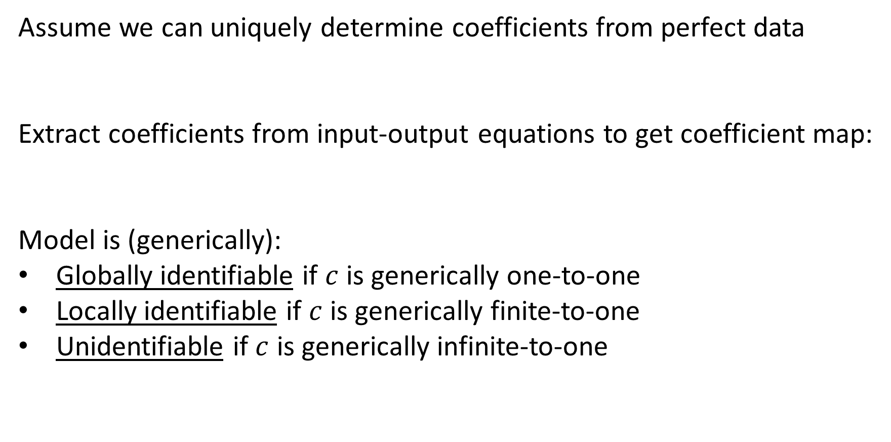
Obtain coefficient map
Assume we can uniquely determine coefficients from perfect data
Extract coefficients from input-output equations to get coefficient map:
Model is (generically):
Globally identifiable if $c$ is generically one-to-one
Locally identifiable if $c$ is generically finite-to-one
Unidentifiable if $c$ is generically infinite-to-one
$${\ddot{y}}_{1}+\left(a_{01}+a_{02}+a_{12}+a_{21}\right){\dot{y}}_{1}+(a_{01}a_{12}+a_{02}a_{21}+a_{01}a_{02})y_{1}={\dot{u}}_{1}+(a_{02}+a_{12})u_{1}$$
$$p⟼c(p)$$
$\left(a_{01},a_{02}, a_{12}, a_{21}\right)⟼(a_{01}+a_{02}+a_{12}+a_{21}$, $a_{01}a_{12}+a_{02}a_{21}+a_{01}a_{02}$, $a_{02}+a_{12})$

Slide 35
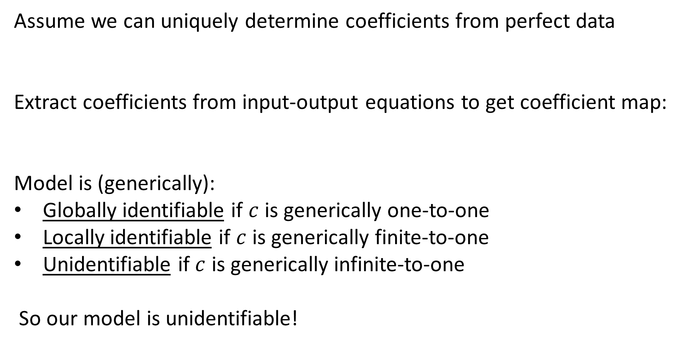
Obtain coefficient map
Assume we can uniquely determine coefficients from perfect data
Extract coefficients from input-output equations to get coefficient map:
Model is (generically):
Globally identifiable if $c$ is generically one-to-one
Locally identifiable if $c$ is generically finite-to-one
Unidentifiable if $c$ is generically infinite-to-one
So our model is unidentifiable!
$${\ddot{y}}_{1}+\left(a_{01}+a_{02}+a_{12}+a_{21}\right){\dot{y}}_{1}+(a_{01}a_{12}+a_{02}a_{21}+a_{01}a_{02})y_{1}={\dot{u}}_{1}+(a_{02}+a_{12})u_{1}$$
$$p⟼c(p)$$
$\left(a_{01},a_{02}, a_{12}, a_{21}\right)⟼(a_{01}+a_{02}+a_{12}+a_{21}$, $a_{01}a_{12}+a_{02}a_{21}+a_{01}a_{02}$, $a_{02}+a_{12})$

Slide 36
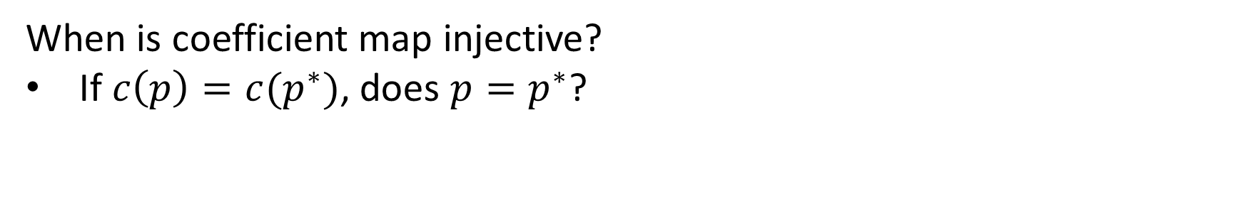
Testing injectivity
When is coefficient map injective?
If $c\left(p\right)=c(p^{∗})$, does $p=p^{∗}$?

Slide 37
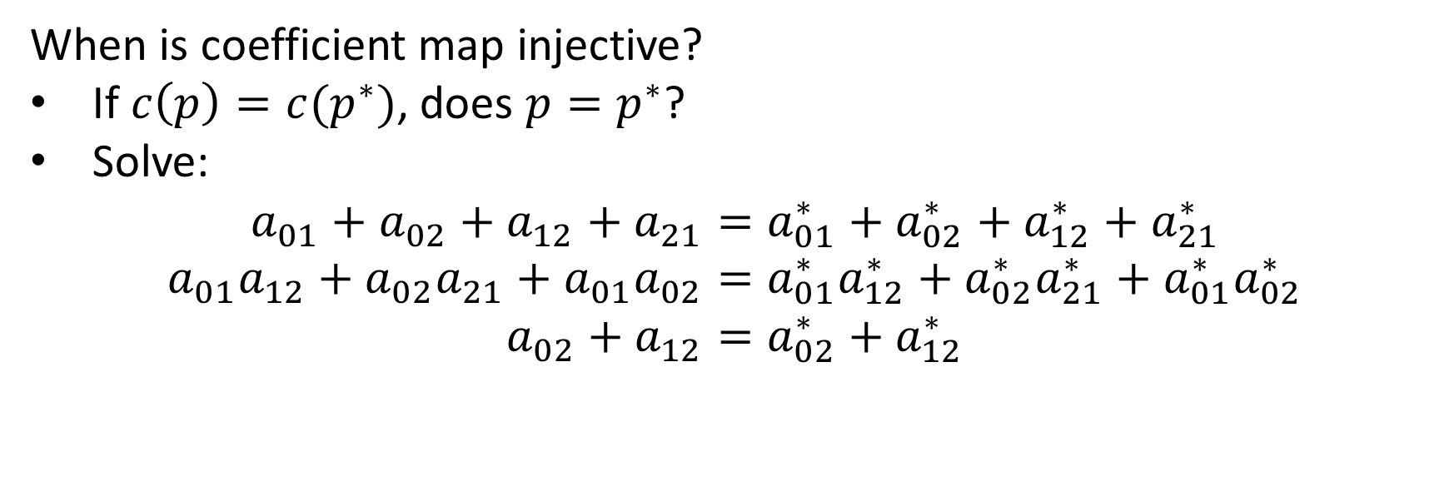
Testing injectivity
When is coefficient map injective?
If $c\left(p\right)=c(p^{∗})$, does $p=p^{∗}$?
Solve:
$$a_{01}+a_{02}+a_{12}+a_{21}=a_{01}^{∗}+a_{02}^{∗}+a_{12}^{∗}+a_{21}^{∗}$$
$$a_{01}a_{12}+a_{02}a_{21}+a_{01}a_{02}=a_{01}^{∗}a_{12}^{∗}+a_{02}^{∗}a_{21}^{∗}+a_{01}^{∗}a_{02}^{∗}$$
$$a_{02}+a_{12}=a_{02}^{∗}+a_{12}^{∗}$$

Slide 38

Testing injectivity
When is coefficient map injective?
If $c\left(p\right)=c(p^{∗})$, does $p=p^{∗}$?
Solve:
$$a_{01}=−\frac{a_{12}^{∗}a_{21}^{∗}}{a_{12}}+a_{01}^{∗}+a_{21}^{∗}$$
$$a_{21}=\frac{a_{12}^{∗}a_{21}^{∗}}{a_{12}}$$
$$a_{02}=−a_{12}+a_{02}^{∗}+a_{12}^{∗}$$

Slide 39

Testing injectivity
When is coefficient map injective?
If $c\left(p\right)=c(p^{∗})$, does $p=p^{∗}$?
Solve:
$$a_{01}=−a_{21}+a_{01}^{∗}+a_{21}^{∗}$$
$$a_{21}=\frac{a_{12}^{∗}a_{21}^{∗}}{a_{12}}$$
$$a_{02}=−a_{12}+a_{02}^{∗}+a_{12}^{∗}$$

Slide 40
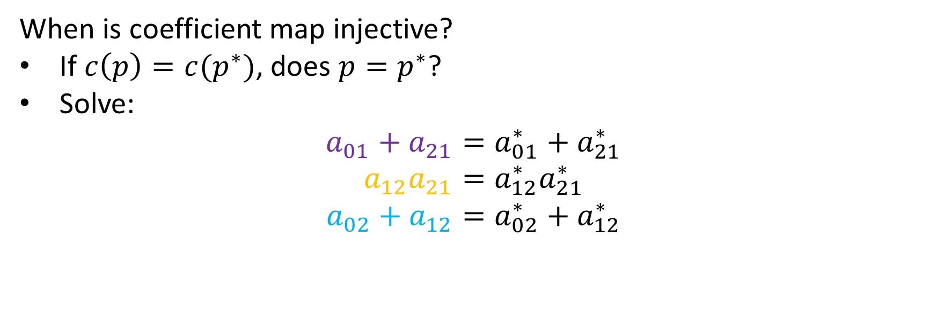
Testing injectivity
When is coefficient map injective?
If $c\left(p\right)=c(p^{∗})$, does $p=p^{∗}$?
Solve:
$$a_{01}+a_{21}=a_{01}^{∗}+a_{21}^{∗}$$
$${a_{12}a}_{21}=a_{12}^{∗}a_{21}^{∗}$$
$$a_{02}+a_{12}=a_{02}^{∗}+a_{12}^{∗}$$

Slide 41
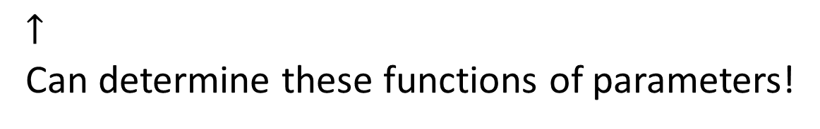
Testing injectivity
When is coefficient map injective?
If $c\left(p\right)=c(p^{∗})$, does $p=p^{∗}$?
Solve:
$$a_{01}+a_{21}=a_{01}^{∗}+a_{21}^{∗}$$
$${a_{12}a}_{21}=a_{12}^{∗}a_{21}^{∗}$$
$$a_{02}+a_{12}=a_{02}^{∗}+a_{12}^{∗}$$
$↑$
Can determine these functions of parameters!

Slide 42
Testing injectivity
When is coefficient map injective?
Faster: Check dimension of image of coefficient map

Slide 43
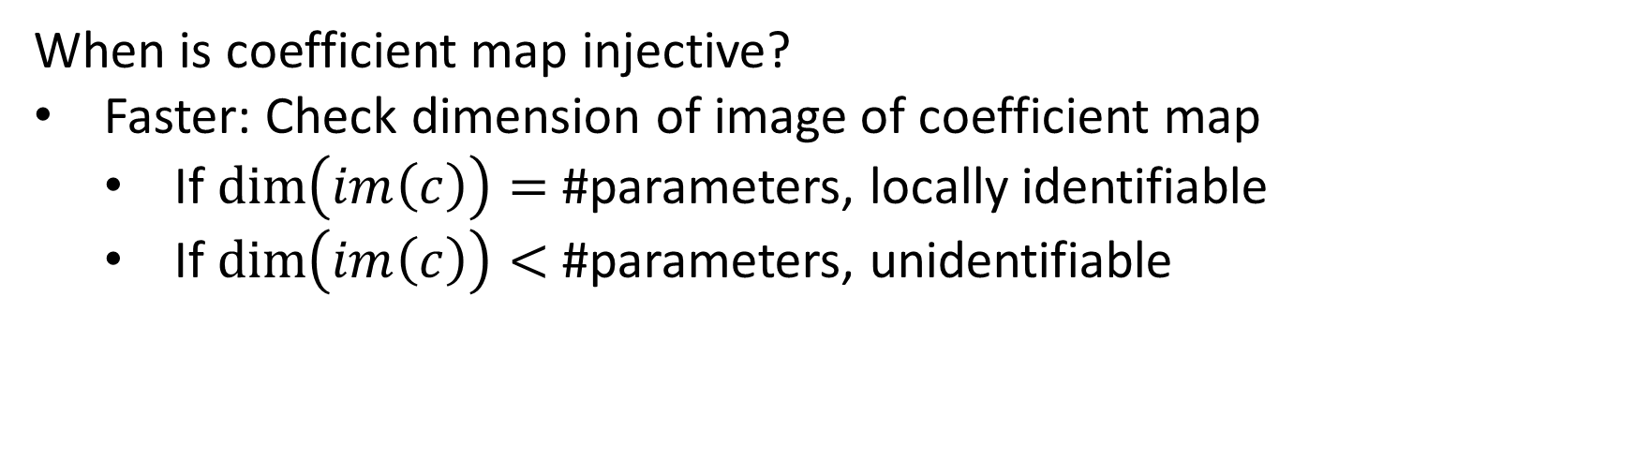
Testing injectivity
When is coefficient map injective?
Faster: Check dimension of image of coefficient map
  If $\dim\left(im\left(c\right)\right)=$ #parameters, locally identifiable
  If $\dim\left(im\left(c\right)\right)<$ #parameters, unidentifiable

Slide 44
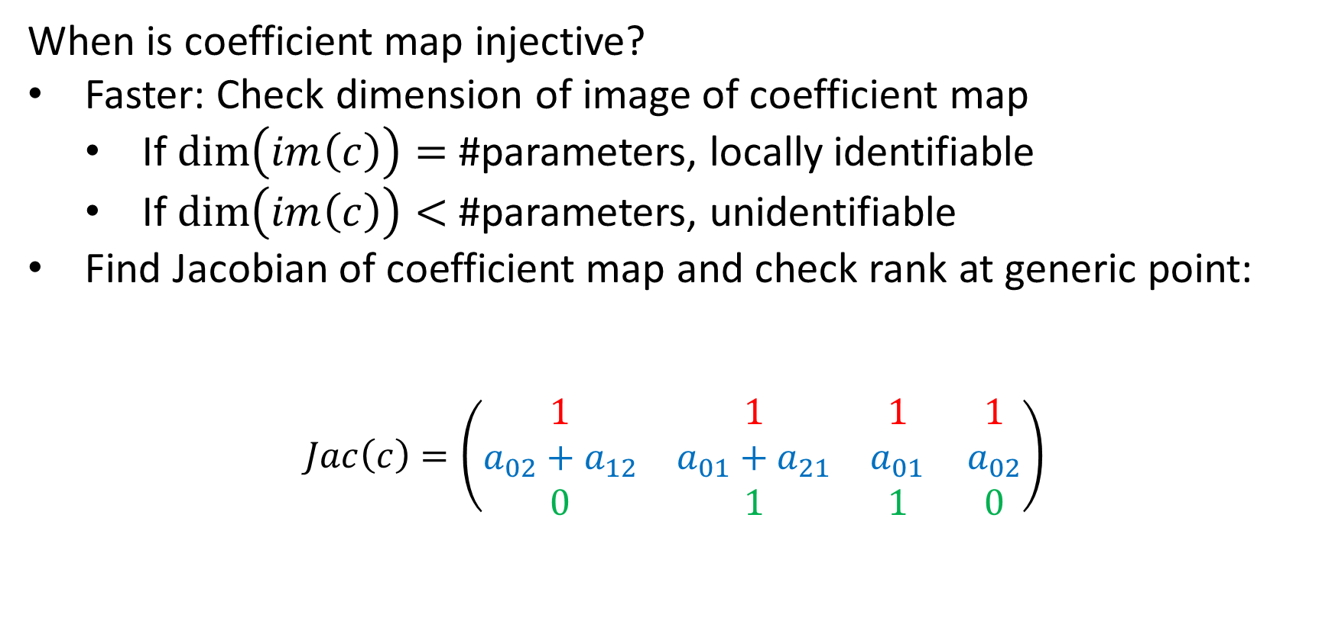
Testing injectivity
When is coefficient map injective?
Faster: Check dimension of image of coefficient map
  If $\dim\left(im\left(c\right)\right)=$ #parameters, locally identifiable
  If $\dim\left(im\left(c\right)\right)<$ #parameters, unidentifiable
Find Jacobian of coefficient map and check rank at generic point:
$$Jac\left(c\right)=\left(\begin{matrix}1 & 1 & 1 \\ a_{02}+a_{12} & a_{01}+a_{21} & a_{01} \\ 0 & 1 & 1\end{matrix} \begin{matrix}1 \\ a_{02} \\ 0\end{matrix}\right)$$
$c\left(a_{01},a_{02}, a_{12}, a_{21}\right)=(a_{01}+a_{02}+a_{12}+a_{21}$, $a_{01}a_{12}+a_{02}a_{21}+a_{01}a_{02}$, $a_{02}+a_{12})$

Slide 45
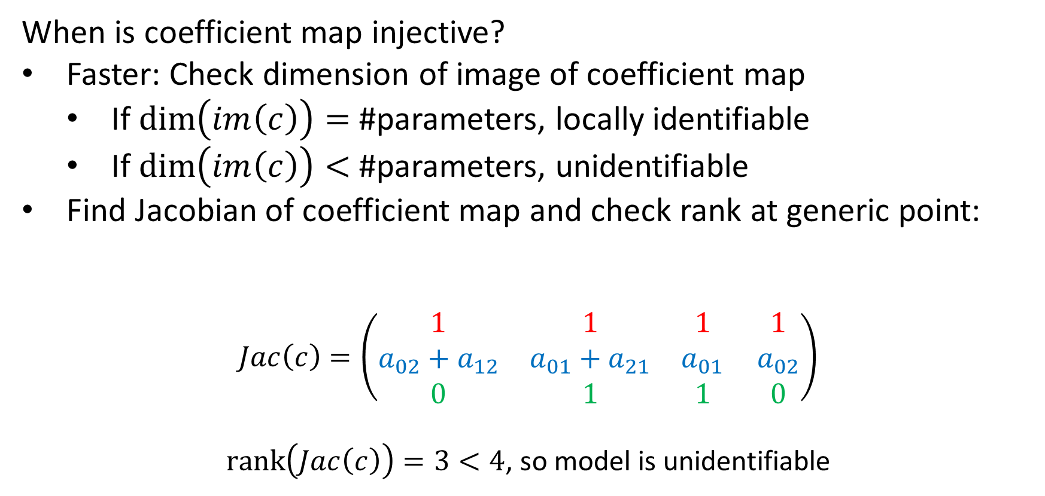
Testing injectivity
When is coefficient map injective?
Faster: Check dimension of image of coefficient map
  If $\dim\left(im\left(c\right)\right)=$ #parameters, locally identifiable
  If $\dim\left(im\left(c\right)\right)<$ #parameters, unidentifiable
Find Jacobian of coefficient map and check rank at generic point:
$$Jac\left(c\right)=\left(\begin{matrix}1 & 1 & 1 \\ a_{02}+a_{12} & a_{01}+a_{21} & a_{01} \\ 0 & 1 & 1\end{matrix} \begin{matrix}1 \\ a_{02} \\ 0\end{matrix}\right)$$
$\operatorname{rank}\left(Jac\left(c\right)\right)=3<4$, so model is unidentifiable
$c\left(a_{01},a_{02}, a_{12}, a_{21}\right)=(a_{01}+a_{02}+a_{12}+a_{21}$, $a_{01}a_{12}+a_{02}a_{21}+a_{01}a_{02}$, $a_{02}+a_{12})$

Slide 46
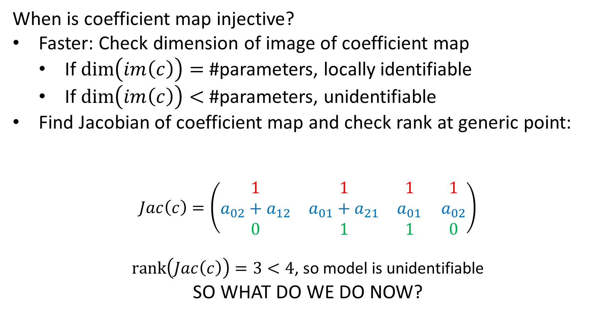
Testing injectivity
When is coefficient map injective?
Faster: Check dimension of image of coefficient map
  If $\dim\left(im\left(c\right)\right)=$ #parameters, locally identifiable
  If $\dim\left(im\left(c\right)\right)<$ #parameters, unidentifiable
Find Jacobian of coefficient map and check rank at generic point:
$$Jac\left(c\right)=\left(\begin{matrix}1 & 1 & 1 \\ a_{02}+a_{12} & a_{01}+a_{21} & a_{01} \\ 0 & 1 & 1\end{matrix} \begin{matrix}1 \\ a_{02} \\ 0\end{matrix}\right)$$
$\operatorname{rank}\left(Jac\left(c\right)\right)=3<4$, so model is unidentifiable
SO WHAT DO WE DO NOW?
$c\left(a_{01},a_{02}, a_{12}, a_{21}\right)=(a_{01}+a_{02}+a_{12}+a_{21}$, $a_{01}a_{12}+a_{02}a_{21}+a_{01}a_{02}$, $a_{02}+a_{12})$

Slide 47
What to do with an unidentifiable model?
Some options:

Slide 48
What to do with an unidentifiable model?
Some options:
  Give up!

Slide 49
What to do with an unidentifiable model?
Some options:
  Add more data! (increase the number of coefficients)

Slide 50
What to do with an unidentifiable model?
Some options:
  Add more data! (increase the number of coefficients)
  Remove edges/leaks! (decrease the number of parameters)

Slide 51
What to do with an unidentifiable model?
Some options:
  Add more data! (increase the number of coefficients)
  Remove edges/leaks! (decrease the number of parameters)
  Reparametrize!

Slide 52
What to do with an unidentifiable model?
Some options:
  Add more data! (increase the number of coefficients)
  Remove edges/leaks! (decrease the number of parameters)
  Reparametrize!

Slide 53
What to do with an unidentifiable model?
Option #1. Find an identifiable reparametrization
  Reparametrize in terms of identifiable functions of parameters (“identifiable combinations”)

Slide 54
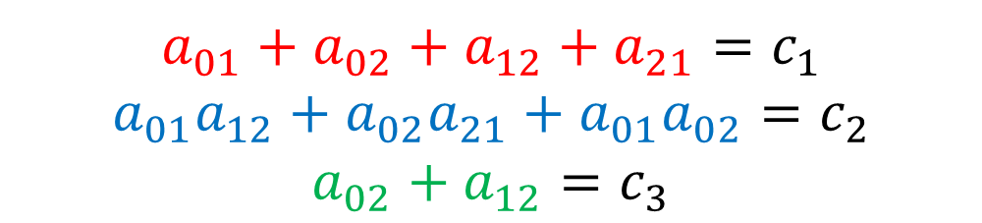
What to do with an unidentifiable model?
Option #1. Find an identifiable reparametrization
  Reparametrize in terms of identifiable functions of parameters (“identifiable combinations”)
  Identifiable functions can be written in terms of the coefficients:
$$a_{01}+a_{02}+a_{12}+a_{21}=c_{1}$$
$$a_{01}a_{12}+a_{02}a_{21}+a_{01}a_{02}=c_{2}$$
$$a_{02}+a_{12}=c_{3}$$

Slide 55
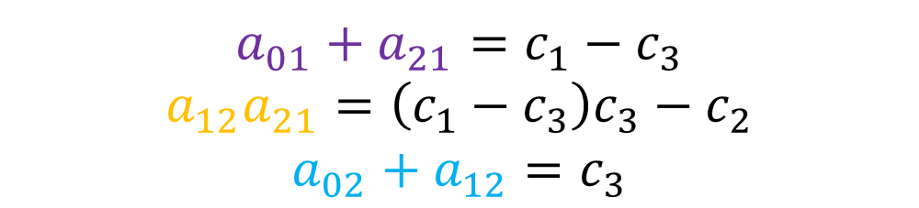
What to do with an unidentifiable model?
Option #1. Find an identifiable reparametrization
  Reparametrize in terms of identifiable functions of parameters (“identifiable combinations”)
  Identifiable functions can be written in terms of the coefficients:
$$a_{01}+a_{21}=c_{1}−c_{3}$$
$$a_{12}a_{21}=\left(c_{1}−c_{3}\right)c_{3}−c_{2}$$
$$a_{02}+a_{12}=c_{3}$$

Slide 56
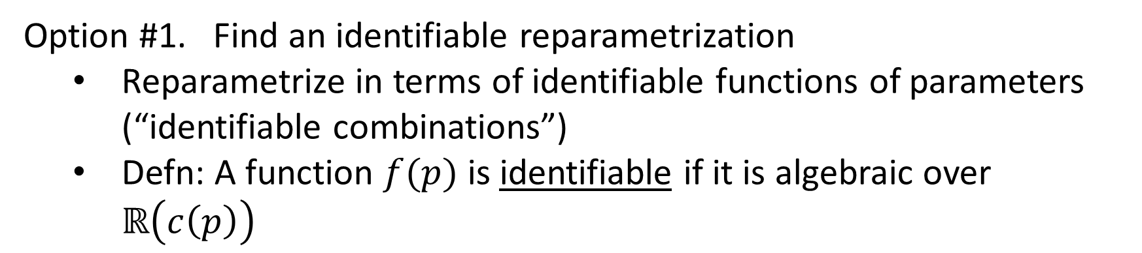
What to do with an unidentifiable model?
Option #1. Find an identifiable reparametrization
  Reparametrize in terms of identifiable functions of parameters (“identifiable combinations”)
  Defn: A function $f(p)$ is identifiable if it is algebraic over $ℝ\left(c\left(p\right)\right)$
$$a_{01}+a_{21}=c_{1}−c_{3}$$
$$a_{12}a_{21}=\left(c_{1}−c_{3}\right)c_{3}−c_{2}$$
$$a_{02}+a_{12}=c_{3}$$

Slide 57
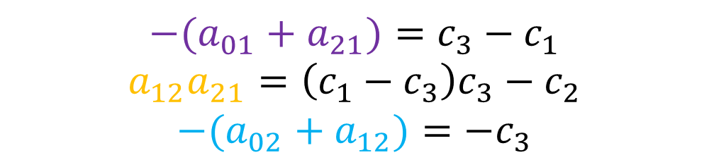
What to do with an unidentifiable model?
Option #1. Find an identifiable reparametrization
  Reparametrize in terms of identifiable functions of parameters (“identifiable combinations”)
  Defn: A function $f(p)$ is identifiable if it is algebraic over $ℝ\left(c\left(p\right)\right)$
$$−(a_{01}+a_{21})=c_{3}−c_{1}$$
$$a_{12}a_{21}=\left(c_{1}−c_{3}\right)c_{3}−c_{2}$$
$$−(a_{02}+a_{12})=−c_{3}$$

Slide 58
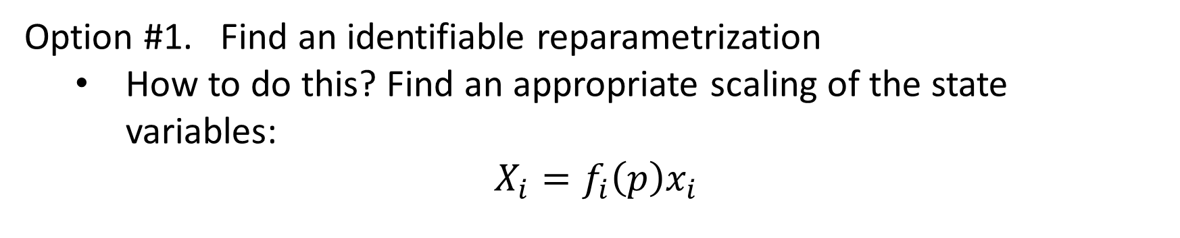
What to do with an unidentifiable model?
Option #1. Find an identifiable reparametrization
  How to do this? Find an appropriate scaling of the state variables:
$$X_{i}=f_{i}\left(p\right)x_{i}$$

Slide 59







What to do with an unidentifiable model?
Option #1. Find an identifiable reparametrization
  How to do this? Find an appropriate scaling of the state variables:
$$X_{i}=f_{i}\left(p\right)x_{i}$$
$${\dot{x}}_{1}=−\left(a_{01}+a_{21}\right)x_{1}+a_{12}x_{2}+u_{1}$$
$${\dot{X}}_{1}=−\left(a_{01}+a_{21}\right)X_{1}+X_{2}+u_{1}$$
$${\dot{x}}_{2}=a_{21}x_{1}−(a_{02}+a_{12}) x_{2}$$
$${\dot{X}}_{2}=a_{12}a_{21}X_{1}−(a_{02}+a_{12}) X_{2}$$
$$X_{1}=x_{1}$$
$$y_{1}=x_{1}$$
$$y_{1}=X_{1}$$
$$X_{2}={a_{12}x}_{2}$$

Slide 60


What to do with an unidentifiable model?
Option #1. Find an identifiable reparametrization
  How to do this? Find an appropriate scaling of the state variables:
$$X_{i}=f_{i}\left(p\right)x_{i}$$
$${\dot{x}}_{1}=−\left(a_{01}+a_{21}\right)x_{1}+a_{12}x_{2}+u_{1}$$
$${\dot{X}}_{1}=q_{1}X_{1}+X_{2}+u_{1}$$
$${\dot{x}}_{2}=a_{21}x_{1}−(a_{02}+a_{12}) x_{2}$$
$${\dot{X}}_{2}=q_{2}X_{1}+q_{3}X_{2}$$
$$X_{1}=x_{1}$$
$$y_{1}=x_{1}$$
$$y_{1}=X_{1}$$
$$X_{2}={a_{12}x}_{2}$$

Slide 61
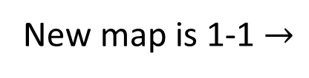
What to do with an unidentifiable model?
Option #1. Find an identifiable reparametrization
  How to do this? Find an appropriate scaling of the state variables:
$$X_{i}=f_{i}\left(p\right)x_{i}$$
$${\dot{x}}_{1}=−\left(a_{01}+a_{21}\right)x_{1}+a_{12}x_{2}+u_{1}$$
$${\dot{X}}_{1}=q_{1}X_{1}+X_{2}+u_{1}$$
$${\dot{x}}_{2}=a_{21}x_{1}−(a_{02}+a_{12}) x_{2}$$
$${\dot{X}}_{2}=q_{2}X_{1}+q_{3}X_{2}$$
$$X_{1}=x_{1}$$
$$y_{1}=x_{1}$$
$$y_{1}=X_{1}$$
$$X_{2}={a_{12}x}_{2}$$
New map is 1-1 $→$
$$c\left(q_{1}, q_{2}, q_{3}\right)=(−q_{1}−q_{3}, { q}_{1}q_{3}−q_{2}, { −q}_{3})$$

Slide 62
What to do with an unidentifiable model?
Option #1. Find an identifiable reparametrization
  How to do this? Find an appropriate scaling of the state variables:
$$X_{i}=f_{i}\left(p\right)x_{i}$$
$${\dot{x}}_{1}=−\left(a_{01}+a_{21}\right)x_{1}+a_{12}x_{2}+u_{1}$$
$${\dot{X}}_{1}=q_{1}X_{1}+X_{2}+u_{1}$$
$${\dot{x}}_{2}=a_{21}x_{1}−(a_{02}+a_{12}) x_{2}$$
$${\dot{X}}_{2}=q_{2}X_{1}+q_{3}X_{2}$$
$$X_{1}=x_{1}$$
$$y_{1}=x_{1}$$
$$y_{1}=X_{1}$$
$$X_{2}={a_{12}x}_{2}$$
Is this useful??? Does this always work???

Slide 63





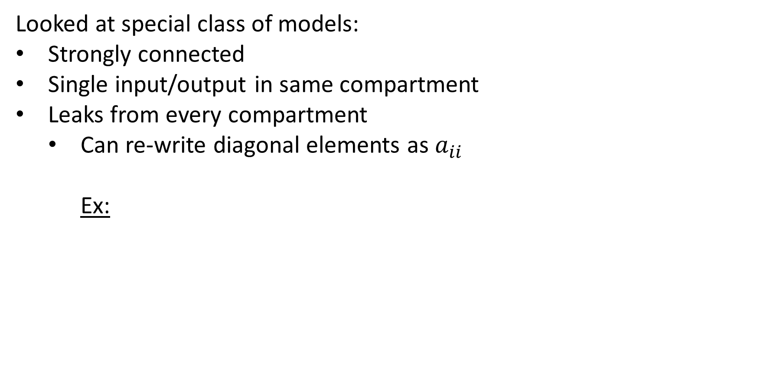






Identifiable scaling reparametrization
$$u_{1}$$
$$y_{1}$$
Looked at special class of models:
Strongly connected
Single input/output in same compartment
Leaks from every compartment
  Can re-write diagonal elements as $a_{ii}$
    Ex:
$$a_{21}$$
$$x_{1}$$
$$x_{2}$$
$$a_{12}$$
$$a_{01}$$
$$a_{02}$$
$${\dot{x}}_{1}=a_{11}x_{1}+a_{12}x_{2}+u_{1}$$
$${\dot{x}}_{2}=a_{21}x_{1}+a_{22}x_{2}$$
$$y_{1}=x_{1}$$

Slide 64

Identifiable scaling reparametrization
$$u_{1}$$
$$y_{1}$$
Looked at special class of models:
Strongly connected
Single input/output in same compartment
Leaks from every compartment
  Can re-write diagonal elements as $a_{ii}$
    Ex:
$$a_{21}$$
$$x_{1}$$
$$x_{2}$$
$$a_{12}$$
$$a_{01}$$
$$a_{02}$$
$${\dot{x}}_{1}=a_{11}x_{1}+a_{12}x_{2}+u_{1}$$
$${\dot{x}}_{2}=a_{21}x_{1}+a_{22}x_{2}$$
Graph $G$ with $m$ edges and $n$ vertices
$$y_{1}=x_{1}$$

Slide 65
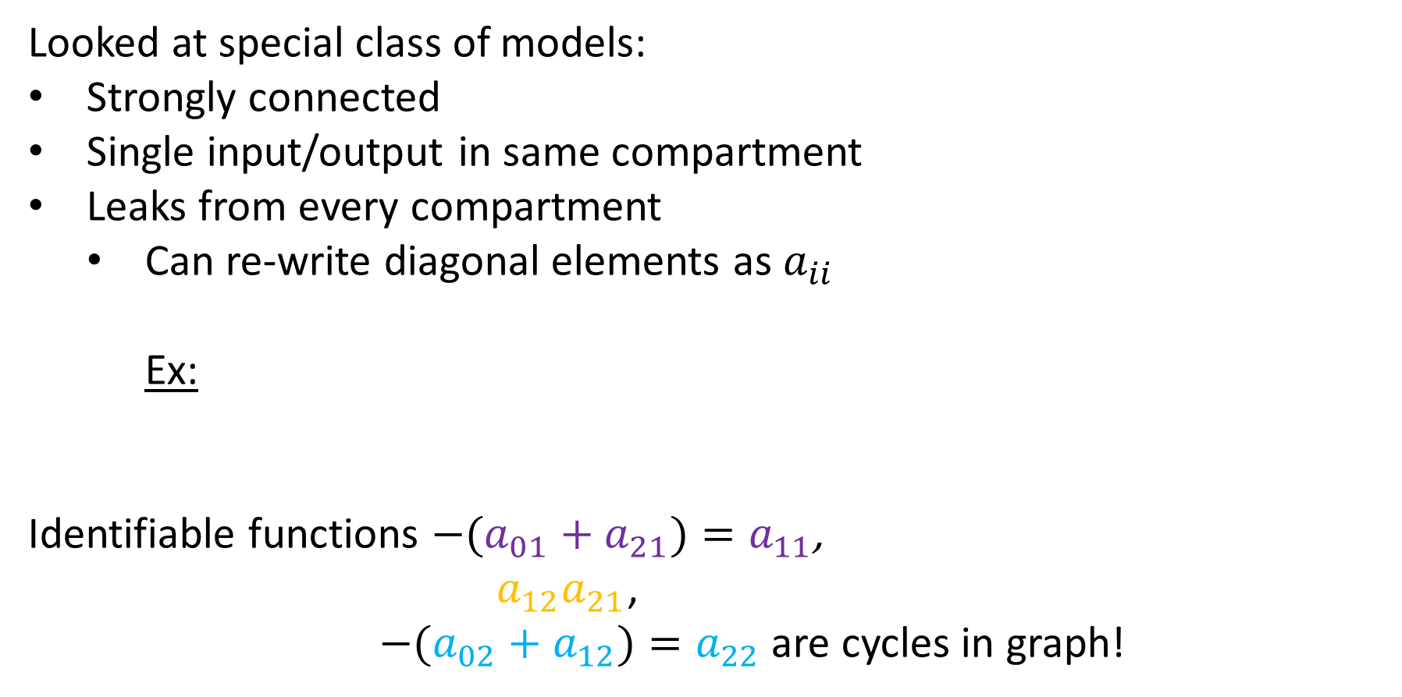
Identifiable scaling reparametrization
$$u_{1}$$
$$y_{1}$$
Looked at special class of models:
Strongly connected
Single input/output in same compartment
Leaks from every compartment
  Can re-write diagonal elements as $a_{ii}$
    Ex:
Identifiable functions $−(a_{01}+a_{21})=a_{11}$,
$a_{12}a_{21}$,
$−(a_{02}+a_{12})=a_{22}$ are cycles in graph!
$$a_{21}$$
$$x_{1}$$
$$x_{2}$$
$$a_{12}$$
$$a_{01}$$
$$a_{02}$$
$${\dot{x}}_{1}=a_{11}x_{1}+a_{12}x_{2}+u_{1}$$
$${\dot{x}}_{2}=a_{21}x_{1}+a_{22}x_{2}$$
Graph $G$ with $m$ edges and $n$ vertices
$$y_{1}=x_{1}$$

Slide 66
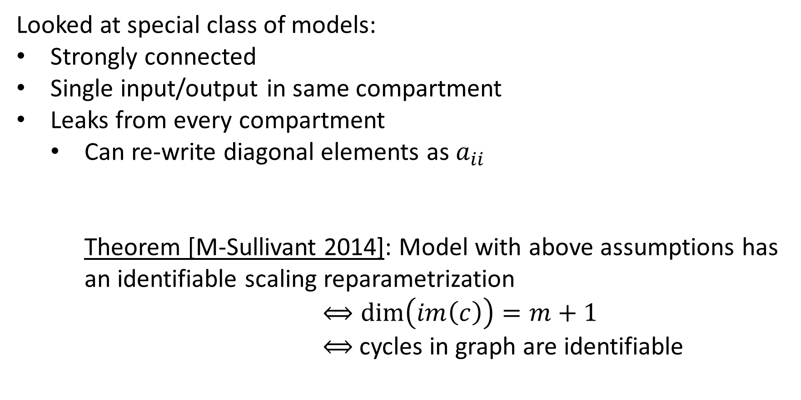
Identifiable scaling reparametrization
$$u_{1}$$
$$y_{1}$$
Looked at special class of models:
Strongly connected
Single input/output in same compartment
Leaks from every compartment
  Can re-write diagonal elements as $a_{ii}$
    Theorem [M-Sullivant 2014]: Model with above assumptions has an identifiable scaling reparametrization $⟺\dim\left(im\left(c\right)\right)=m+1$ $⟺$ cycles in graph are identifiable
$$a_{21}$$
$$x_{1}$$
$$x_{2}$$
$$a_{12}$$
$$a_{01}$$
$$a_{02}$$

Slide 67

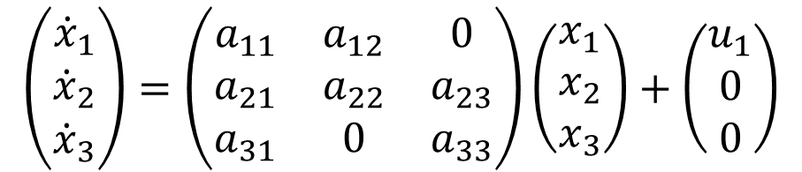



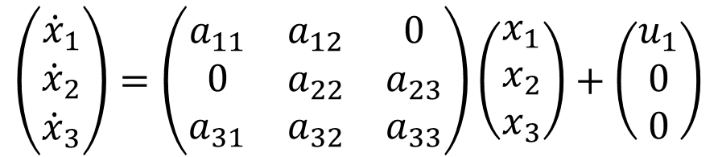
Examples
Model 1
Model 2
2
2
1
3
1
3
$$\left(\begin{matrix}{\dot{x}}_{1} \\ {\dot{x}}_{2} \\ {\dot{x}}_{3}\end{matrix}\right)=\left(\begin{matrix}a_{11} & a_{12} & 0 \\ 0 & a_{22} & a_{23} \\ a_{31} & a_{32} & a_{33}\end{matrix}\right)\left(\begin{matrix}x_{1} \\ x_{2} \\ x_{3}\end{matrix}\right)+\left(\begin{matrix}u_{1} \\ 0 \\ 0\end{matrix}\right)$$
$$\left(\begin{matrix}{\dot{x}}_{1} \\ {\dot{x}}_{2} \\ {\dot{x}}_{3}\end{matrix}\right)=\left(\begin{matrix}a_{11} & a_{12} & 0 \\ a_{21} & a_{22} & a_{23} \\ a_{31} & 0 & a_{33}\end{matrix}\right)\left(\begin{matrix}x_{1} \\ x_{2} \\ x_{3}\end{matrix}\right)+\left(\begin{matrix}u_{1} \\ 0 \\ 0\end{matrix}\right)$$
$$y_{1}=x_{1}$$
$$y_{1}=x_{1}$$
$$\dim\left(im\left(c\right)\right)=4$$
$$\dim\left(im\left(c\right)\right)=5$$
No identifiable scaling reparametrization!
Has an identifiable scaling reparametrization

Slide 68


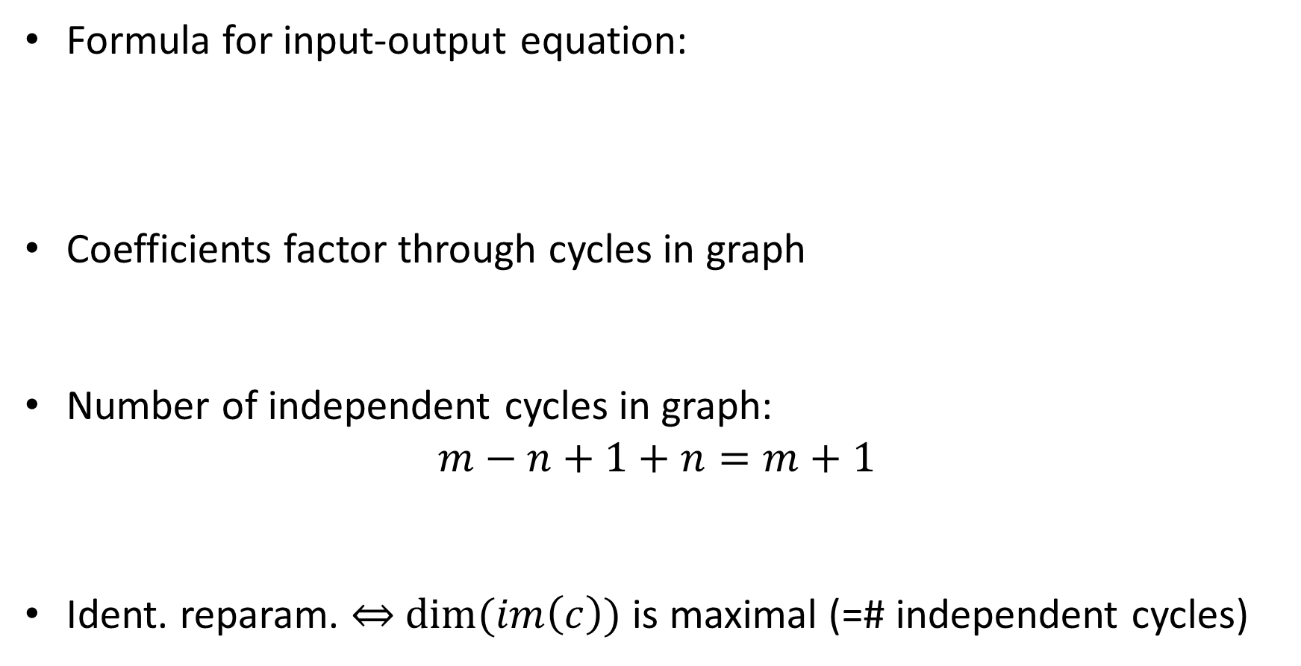



Idea behind proofs
Formula for input-output equation:
Coefficients factor through cycles in graph
Number of independent cycles in graph:
$$m−n+1+n=m+1$$
Ident. reparam. $⇔$ $dim⁡(im\left(c\right))$ is maximal (=# independent cycles)
$${\ddot{y}}_{1}−\left(a_{11}+a_{22}\right){\dot{y}}_{1}+\left(a_{11}a_{22}−a_{12}a_{21}\right)y_{1}={\dot{u}}_{1}−a_{22}u_{1}$$
Coefficients of characteristic polynomial of $A$
… of $A_{11}$
$$c_{1}=−(a_{11}+a_{22})$$
$$c_{2}=a_{11}a_{22}−a_{12}a_{21}$$
$$c_{3}=−a_{22}$$
# cycles
# self cycles

Slide 69

















What to do with an unidentifiable model?
Option #2. Adjust model, if experimentally feasible
  Add inputs or outputs
$$u_{1}$$
$$y_{1}$$
$$u_{1}$$
$$y_{1}$$
$$y_{2}$$
$$a_{21}$$
$$a_{21}$$
$$x_{1}$$
$$x_{2}$$
$$x_{1}$$
$$x_{2}$$
$$a_{12}$$
$$a_{12}$$
$$a_{01}$$
$$a_{02}$$
$$a_{01}$$
$$a_{02}$$
Unidentifiable
Identifiable

Slide 70

What to do with an unidentifiable model?
Option #2. Adjust model, if experimentally feasible
  Add inputs or outputs
$$u_{1}$$
$$y_{1}$$
$$u_{1}$$
$$y_{1}$$
$$u_{2}$$
$$a_{21}$$
$$a_{21}$$
$$x_{1}$$
$$x_{2}$$
$$x_{1}$$
$$x_{2}$$
$$a_{12}$$
$$a_{12}$$
$$a_{01}$$
$$a_{02}$$
$$a_{01}$$
$$a_{02}$$
Unidentifiable
Identifiable

Slide 71
What to do with an unidentifiable model?
Option #2. Adjust model, if experimentally feasible
  Add inputs or outputs
  Open: What is a minimal set of inputs or outputs to obtain identifiability?
$$u_{1}$$
$$y_{1}$$
$$u_{1}$$
$$y_{1}$$
$$u_{2}$$
$$a_{21}$$
$$a_{21}$$
$$x_{1}$$
$$x_{2}$$
$$x_{1}$$
$$x_{2}$$
$$a_{12}$$
$$a_{12}$$
$$a_{01}$$
$$a_{02}$$
$$a_{01}$$
$$a_{02}$$
Unidentifiable
Identifiable

Slide 72








What to do with an unidentifiable model?
Option #2. Adjust model, if experimentally feasible
  Remove a leak or edge
$$u_{1}$$
$$y_{1}$$
$$u_{1}$$
$$y_{1}$$
$$a_{21}$$
$$a_{21}$$
$$x_{1}$$
$$x_{2}$$
$$x_{1}$$
$$x_{2}$$
$$a_{12}$$
$$a_{12}$$
$$a_{01}$$
$$a_{02}$$
$$a_{01}$$
Unidentifiable
Identifiable

Slide 73
What to do with an unidentifiable model?
Option #2. Adjust model, if experimentally feasible
  Remove a leak or edge
  Open: For what families can we remove leaks to obtain identifiability?
$$u_{1}$$
$$y_{1}$$
$$u_{1}$$
$$y_{1}$$
$$a_{21}$$
$$a_{21}$$
$$x_{1}$$
$$x_{2}$$
$$x_{1}$$
$$x_{2}$$
$$a_{12}$$
$$a_{12}$$
$$a_{01}$$
$$a_{02}$$
$$a_{01}$$
Unidentifiable
Identifiable

Slide 74
What families of graphs are identifiable?
    Catenary models Mammillary models
1
2
3
3
1
2
[M-Sullivant-Eisenberg 2015, Bortner-M 2022, Gross et al 2023]

Slide 75
What families of graphs are identifiable?
    Bidirectional tree models
3
1
2
4
5
[M-Sullivant-Eisenberg 2015, Bortner-M 2022, Gross et al 2023]

Slide 76
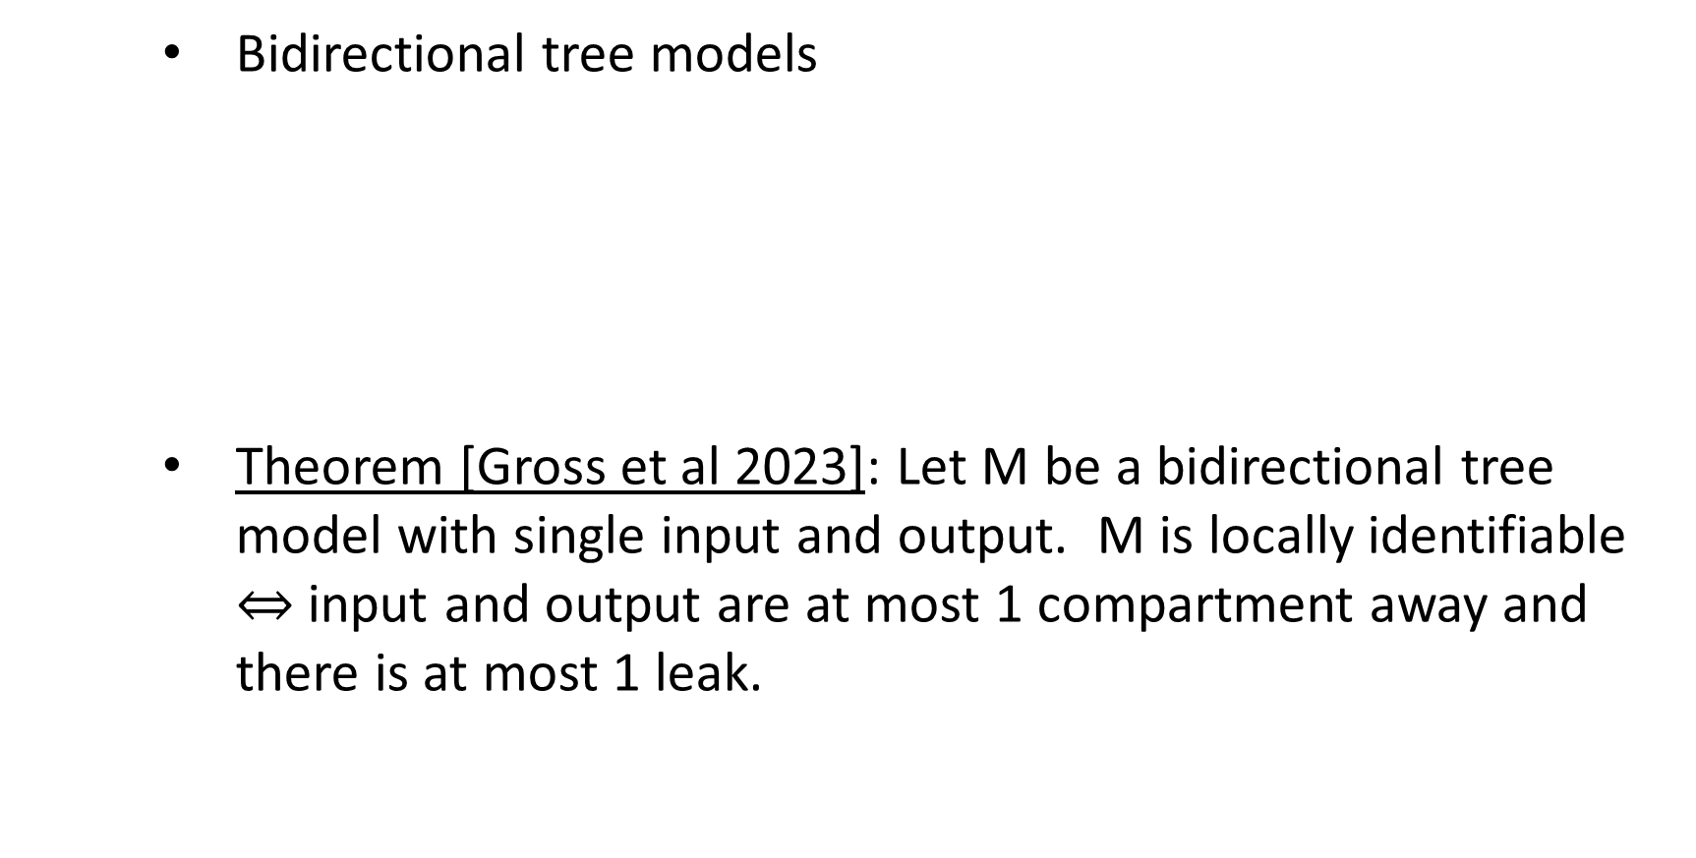
What families of graphs are identifiable?
    Bidirectional tree models
    Theorem [Gross et al 2023]: Let M be a bidirectional tree model with single input and output. M is locally identifiable $⇔$ input and output are at most 1 compartment away and there is at most 1 leak.
3
1
2
4
5
[M-Sullivant-Eisenberg 2015, Bortner-M 2022, Gross et al 2023]

Slide 77
What families of graphs are identifiable?
    Bidirectional tree models
    Cycle models
3
1
2
4
5
1
3
2
[M-Sullivant-Eisenberg 2015, Bortner-M 2022, Gross et al 2023]

Slide 78
What families of graphs are identifiable?
    Bidirectional tree models
    Cycle models
    Path models
3
1
2
4
5
1
3
2
1
2
3
[M-Sullivant-Eisenberg 2015, Bortner-M 2022, Gross et al 2023]

Slide 79



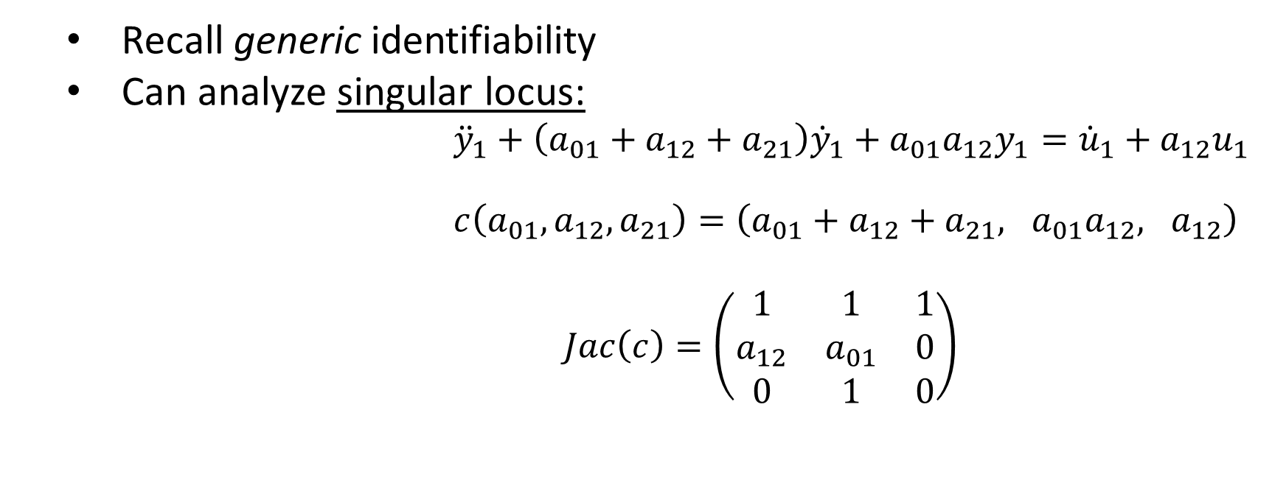




Can identifiability break down?
  Recall generic identifiability
  Can analyze singular locus:
  ${\ddot{y}}_{1}+\left(a_{01}+a_{12}+a_{21}\right){\dot{y}}_{1}+a_{01}a_{12}y_{1}={\dot{u}}_{1}+a_{12}u_{1}$
  $c\left(a_{01},a_{12},a_{21}\right)=\left(a_{01}+a_{12}+a_{21}, a_{01}a_{12}, a_{12}\right)$
  $Jac\left(c\right)=\left(\begin{matrix}1 & 1 & 1 \\ a_{12} & a_{01} & 0 \\ 0 & 1 & 0\end{matrix}\right)$
$$u_{1}$$
$$y_{1}$$
$$a_{21}$$
$$x_{1}$$
$$x_{2}$$
$$a_{12}$$
$$a_{01}$$
Identifiable

Slide 80
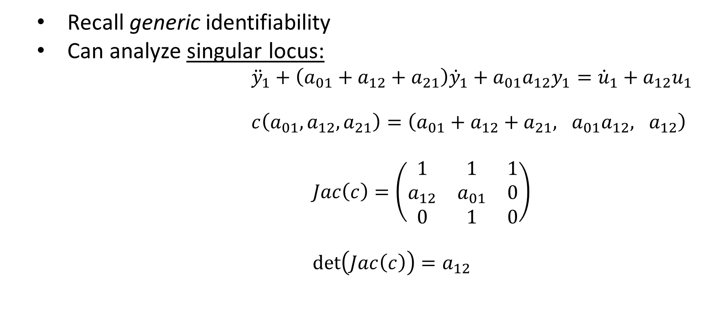
Can identifiability break down?
  Recall generic identifiability
  Can analyze singular locus:
  ${\ddot{y}}_{1}+\left(a_{01}+a_{12}+a_{21}\right){\dot{y}}_{1}+a_{01}a_{12}y_{1}={\dot{u}}_{1}+a_{12}u_{1}$
  $c\left(a_{01},a_{12},a_{21}\right)=\left(a_{01}+a_{12}+a_{21}, a_{01}a_{12}, a_{12}\right)$
  $Jac\left(c\right)=\left(\begin{matrix}1 & 1 & 1 \\ a_{12} & a_{01} & 0 \\ 0 & 1 & 0\end{matrix}\right)$
  $\det\left(Jac\left(c\right)\right)=a_{12}$
$$u_{1}$$
$$y_{1}$$
$$a_{21}$$
$$x_{1}$$
$$x_{2}$$
$$a_{12}$$
$$a_{01}$$
Identifiable

Slide 81
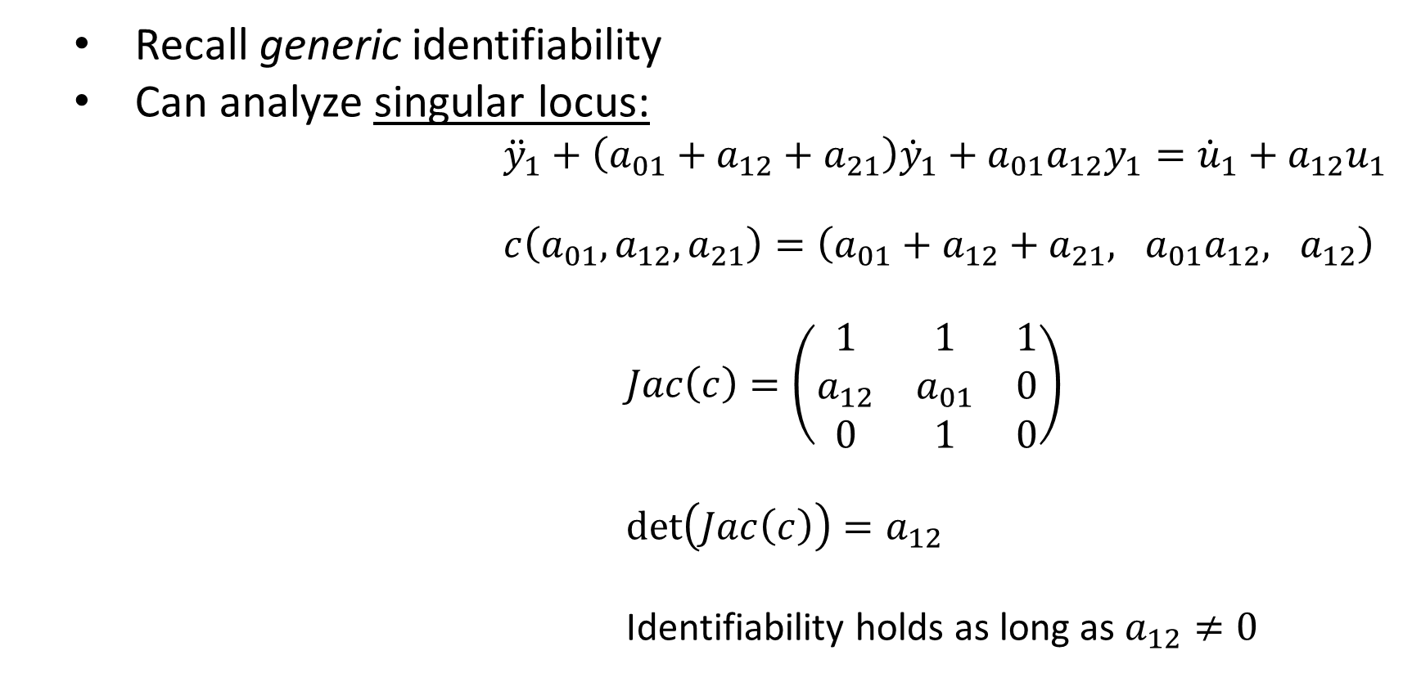
Can identifiability break down?
  Recall generic identifiability
  Can analyze singular locus:
  ${\ddot{y}}_{1}+\left(a_{01}+a_{12}+a_{21}\right){\dot{y}}_{1}+a_{01}a_{12}y_{1}={\dot{u}}_{1}+a_{12}u_{1}$
  $c\left(a_{01},a_{12},a_{21}\right)=\left(a_{01}+a_{12}+a_{21}, a_{01}a_{12}, a_{12}\right)$
  $Jac\left(c\right)=\left(\begin{matrix}1 & 1 & 1 \\ a_{12} & a_{01} & 0 \\ 0 & 1 & 0\end{matrix}\right)$
  $\det\left(Jac\left(c\right)\right)=a_{12}$
  Identifiability holds as long as $a_{12}≠0$
$$u_{1}$$
$$y_{1}$$
$$a_{21}$$
$$x_{1}$$
$$x_{2}$$
$$a_{12}$$
$$a_{01}$$
Identifiable

Slide 82

Singular locus
The singular locus is the subset of the parameter space where the Jacobian matrix of $c$ has rank strictly less than the number of parameters.

Slide 83

Singular locus
The singular locus is the subset of the parameter space where the Jacobian matrix of $c$ has rank strictly less than the number of parameters.
If #parameters = #coefficients, look at $det⁡(Jac\left(c\right))$

Slide 84

Singular locus
The singular locus is the subset of the parameter space where the Jacobian matrix of $c$ has rank strictly less than the number of parameters.
If #parameters = #coefficients, look at $det⁡(Jac\left(c\right))$
If #parameters < #coefficients, look at $r$ by $r$ minors of $Jac\left(c\right)$, where $r$ = # parameters.

Slide 85

Singular locus
The singular locus is the subset of the parameter space where the Jacobian matrix of $c$ has rank strictly less than the number of parameters.
If #parameters = #coefficients, look at $det⁡(Jac\left(c\right))$
If #parameters < #coefficients, look at $r$ by $r$ minors of $Jac\left(c\right)$, where $r$ = # parameters.
Can we find formulas for singular locus equations?

Slide 86
Identifiable models
3
2
1
4
Mammillary
Catenary
Cycle
1
2
3
4
1
2
All identifiable for the case of single input/output/leak in 1st compartment
3
4
[M-Sullivant-Eisenberg 2015]

Slide 87
Singular locus
What does this tell us?
  For cycle and mammillary models, nonzero and distinct parameter values yield identifiability
  For catenary models, nonzero parameter values yield identifiability
[Gross-M-Shiu 2021]

Slide 88








Consider the following models:
Model 1
I/O eqn
$$u_{1}$$
$$y_{3}$$
$$x_{1}$$
$$a_{21}$$
$$x_{2}$$
$$a_{32}$$
$$x_{3}$$
$$a_{01}$$
$${\overset{⃛}{y}}_{3}+\left(a_{32}+a_{01}+a_{21}\right){\ddot{y}}_{3}+\left(a_{01}a_{32}+a_{21}a_{32}\right){\dot{y}}_{3}=a_{21}a_{32}u_{1}$$

Slide 89

Consider the following models:
Model 2
I/O eqn
$$u_{1}$$
$$y_{3}$$
$$x_{1}$$
$$a_{21}$$
$$x_{2}$$
$$a_{32}$$
$$x_{3}$$
$$a_{02}$$
$${\overset{⃛}{y}}_{3}+\left(a_{21}+a_{02}+a_{32}\right){\ddot{y}}_{3}+\left(a_{02}a_{21}+a_{32}a_{21}\right){\dot{y}}_{3}=a_{32}a_{21}u_{1}$$

Slide 90


Consider the following models:
Model 3
I/O eqn
$$u_{1}$$
$$y_{3}$$
$$a_{32}$$
$$x_{1}$$
$$a_{21}$$
$$x_{2}$$
$$x_{3}$$
$$a_{23}$$
$${\overset{⃛}{y}}_{3}+\left(a_{21}+a_{23}+a_{32}\right){\ddot{y}}_{3}+\left(a_{23}a_{21}+a_{32}a_{21}\right){\dot{y}}_{3}=a_{32}a_{21}u_{1}$$

Slide 91

Consider the following models:
Model 1 Model 2 Model 3
Coefficient maps:
$a_{32}+a_{01}+a_{21}$ $a_{21}+a_{02}+a_{32}$ $a_{21}+a_{23}+a_{32}$
$a_{01}a_{32}+a_{21}a_{32}$ $a_{02}a_{21}+a_{32}a_{21}$ $a_{23}a_{21}+a_{32}a_{21}$
$a_{21}a_{32}$ $a_{32}a_{21}$ $a_{32}a_{21}$
1
2
3
1
2
3
1
2
3

Slide 92

Consider the following models:
Model 1 Model 2 Model 3
Coefficient maps:
$a_{32}+a_{01}+a_{21}$ $a_{21}+a_{02}+a_{32}$ $a_{21}+a_{23}+a_{32}$
$a_{01}a_{32}+a_{21}a_{32}$ $a_{02}a_{21}+a_{32}a_{21}$ $a_{23}a_{21}+a_{32}a_{21}$
$a_{21}a_{32}$ $a_{32}a_{21}$ $a_{32}a_{21}$
1
2
3
1
2
3
1
2
3

Slide 93

Consider the following models:
Model 1 Model 2 Model 3
Coefficient maps:
$a_{32}$ $≡$ $a_{21}$ $≡$ $a_{21}$
$a_{01}$ $≡$ $a_{02}$ $≡$ $a_{23}$
$a_{21}$ $≡$ $a_{32}$ $≡$ $a_{32}$
1
2
3
1
2
3
1
2
3

Slide 94
Consider the following models:
Model 1 Model 2 Model 3
Coefficient maps:
$a_{32}$ $≡$ $a_{21}$ $≡$ $a_{21}$
$a_{01}$ $≡$ $a_{02}$ $≡$ $a_{23}$
$a_{21}$ $≡$ $a_{32}$ $≡$ $a_{32}$
1
2
3
1
2
3
1
2
3
Models are
indistinguishable!

Slide 95
Indistinguishability
Two models are indistinguishable if for any choice of parameter values in the first model, there is a choice of parameter values in the second model that will yield the same dynamics, and vice versa
[Walter et al 1984]

Slide 96
Indistinguishability
Two models are indistinguishable if for any choice of parameter values in the first model, there is a choice of parameter values in the second model that will yield the same dynamics, and vice versa
Necessary conditions:
Same input/output variables
[Walter et al 1984]

Slide 97

Indistinguishability
Two models are indistinguishable if for any choice of parameter values in the first model, there is a choice of parameter values in the second model that will yield the same dynamics, and vice versa
Necessary conditions:
Same input/output variables
Same structure of I/O eqns, i.e. same $u$, $y$, $\dot{u}$, $\dot{y}$, … terms appearing
[Walter et al 1984]

Slide 98

Indistinguishability
Two models are indistinguishable if for any choice of parameter values in the first model, there is a choice of parameter values in the second model that will yield the same dynamics, and vice versa
Necessary conditions:
Same input/output variables
Same structure of I/O eqns, i.e. same $u$, $y$, $\dot{u}$, $\dot{y}$, … terms appearing
Coefficients must satisfy the same algebraic dependency relationships
[Walter et al 1984]

Slide 99

Distinguishable models:
Model 1 Model 2
I/O eqn:
${\ddot{y}}_{1}+\left(a_{01}+a_{12}\right){\dot{y}}_{1}+a_{01}a_{12}y_{1}$ ${\ddot{y}}_{1}+\left(b_{02}+b_{12}\right){\dot{y}}_{1}$
$={\dot{u}}_{1}+a_{12}u_{1}$ $={\dot{u}}_{1}+(b_{02}+b_{12})u_{1}$
Not the same I/O eqn structure $⇒$ Distinguishable!
1
2
1
2

Slide 100

Distinguishable models:
Model 1 Model 2
I/O eqn:
${\overset{⃛}{y}}_{3}+\left(a_{32}+a_{01}+a_{21}\right){\ddot{y}}_{3}+\left(a_{01}a_{32}+a_{21}a_{32}\right){\dot{y}}_{3}$ $=a_{21}a_{32}u_{1}+a_{32}{\dot{u}}_{2}+\left(a_{01}a_{32}+a_{21}a_{32}\right)u_{2}$
${\overset{⃛}{y}}_{3}+\left(b_{21}+b_{02}+b_{32}\right){\ddot{y}}_{3}+\left(b_{02}b_{21}+b_{21}b_{32}\right){\dot{y}}_{3}$ $=b_{21}b_{32}u_{1}+b_{32}{\dot{u}}_{2}+\left(b_{21}b_{32}\right)u_{2}$
1
2
3
1
2
3

Slide 101





Distinguishable models:
Model 1 Model 2
I/O eqn:
${\overset{⃛}{y}}_{3}+\left(a_{32}+a_{01}+a_{21}\right){\ddot{y}}_{3}+\left(a_{01}a_{32}+a_{21}a_{32}\right){\dot{y}}_{3}$ $=a_{21}a_{32}u_{1}+a_{32}{\dot{u}}_{2}+\left(a_{01}a_{32}+a_{21}a_{32}\right)u_{2}$
${\overset{⃛}{y}}_{3}+\left(b_{21}+b_{02}+b_{32}\right){\ddot{y}}_{3}+\left(b_{02}b_{21}+b_{21}b_{32}\right){\dot{y}}_{3}$ $=b_{21}b_{32}u_{1}+b_{32}{\dot{u}}_{2}+\left(b_{21}b_{32}\right)u_{2}$
1
2
3
1
2
3
$$c_{1}$$
$$c_{2}$$
$$c_{3}$$
$$c_{4}$$
$$c_{5}$$

Slide 102





Distinguishable models:
Model 1 Model 2
I/O eqn:
${\overset{⃛}{y}}_{3}+\left(a_{32}+a_{01}+a_{21}\right){\ddot{y}}_{3}+\left(a_{01}a_{32}+a_{21}a_{32}\right){\dot{y}}_{3}$ $=a_{21}a_{32}u_{1}+a_{32}{\dot{u}}_{2}+\left(a_{01}a_{32}+a_{21}a_{32}\right)u_{2}$
${\overset{⃛}{y}}_{3}+\left(b_{21}+b_{02}+b_{32}\right){\ddot{y}}_{3}+\left(b_{02}b_{21}+b_{21}b_{32}\right){\dot{y}}_{3}$ $=b_{21}b_{32}u_{1}+b_{32}{\dot{u}}_{2}+\left(b_{21}b_{32}\right)u_{2}$
1
2
3
1
2
3
$$c_{1}$$
$$c_{2}$$
$$c_{3}$$
$$c_{4}$$
$$c_{5}$$

Slide 103

Distinguishable models:
Model 1 Model 2
Algebraic dependency relationships:
Model 1: $c_{2}−c_{5}=0, c_{1}c_{4}−c_{4}^{2}−c_{5}=0$
Model 2: $c_{3}−c_{5}=0, c_{2}c_{4}^{2}−c_{1}c_{4}c_{5}+c_{5}^{2}=0$
$⇒$ Distinguishable!
1
2
3
1
2
3

Slide 104

Indistinguishability
Two models are indistinguishable if for any choice of parameter values in the first model, there is a choice of parameter values in the second model that will yield the same dynamics, and vice versa
Necessary conditions:
Same input/output variables
Same structure of I/O eqns, i.e. same $u$, $y$, $\dot{u}$, $\dot{y}$, … terms appearing
Coefficients must satisfy the same algebraic dependency relationships
How to prove indistinguishability?

Slide 105

Indistinguishability
Two models are indistinguishable if for any choice of parameter values in the first model, there is a choice of parameter values in the second model that will yield the same dynamics, and vice versa
Necessary conditions:
Same input/output variables
Same structure of I/O eqns, i.e. same $u$, $y$, $\dot{u}$, $\dot{y}$, … terms appearing
Coefficients must satisfy the same algebraic dependency relationships
Sufficient: Check that images of coefficient maps are the same
[M-Rosen-Sullivant 2018]

Slide 106

Consider the following models:
Model 1 Model 2 Model 3
Coefficient maps: all surjective
$a_{32}+a_{01}+a_{21}$ $a_{21}+a_{02}+a_{32}$ $a_{21}+a_{23}+a_{32}$
$a_{01}a_{32}+a_{21}a_{32}$ $a_{02}a_{21}+a_{32}a_{21}$ $a_{23}a_{21}+a_{32}a_{21}$
$a_{21}a_{32}$ $a_{32}a_{21}$ $a_{32}a_{21}$
1
2
3
1
2
3
1
2
3

Slide 107
Conditions on graph?
Consider Model 1 and Model 2:
Noticed we “moved the leak down the path”
1
2
3
1
2
3

Slide 108


Detour indistinguishability
Consider path models with a “detour”:
exit and entry nodes $i$ and $j$ with outgoing and incoming edges connecting to graph $G$
1
2
3
4
$$G$$
[Bortner-M, in progress]

Slide 109


Detour indistinguishability
Consider path models with a “detour”:
exit and entry nodes $i$ and $j$ with outgoing and incoming edges connecting to graph $G$
Then we can move the “detour” down the path:
New exit and entry notes are $i+k$ and $j+k$
These models are indistinguishable
1
2
3
4
1
2
3
4
$$G$$
$$G$$
[Bortner-M, in progress]

Slide 110
Final thoughts…
Can we answer these same types of questions for nonlinear models?
Ex: $A+B→2B, B→A$
$${\dot{x}}_{1}=−k_{1}x_{1}x_{2}+k_{2}x_{2}$$
$${\dot{x}}_{2}=k_{1}x_{1}x_{2}−k_{2}x_{2}$$
$$y_{1}=x_{1}$$

Slide 111
Thank you!
Questions?

Slide 112
Generalization
Theorem (M-Sullivant-Eisenberg) Let $M=(G, In, Out, Leak)$ be a linear compartmental model with at least one input. Then the following equations are input-output equations for $M$ for each $i∈Out:$
$\det\left(∂I−A\right)y_{i}=\sum_{j∈In}{{\left(−1\right)}^{i+j}\det{{\left(∂I−A\right)}_{ij}}u_{1}}$

