Slide 1
Modelling in matematics and computer science
- two sides or the same side of a coin
András Pataricza
pataric@mit.bme.hu

Slide 2
What’s a model?
"The sciences
  do not try to explain,
  they hardly even try to interpret,
  they mainly make models.
By a model is meant
  a mathematical construct which,
    with the addition of certain verbal interpretations,
    describes observed phenomena.
The justification of such a mathematical construct is solely and precisely that it is expected to work.„
Neumann János

Slide 3
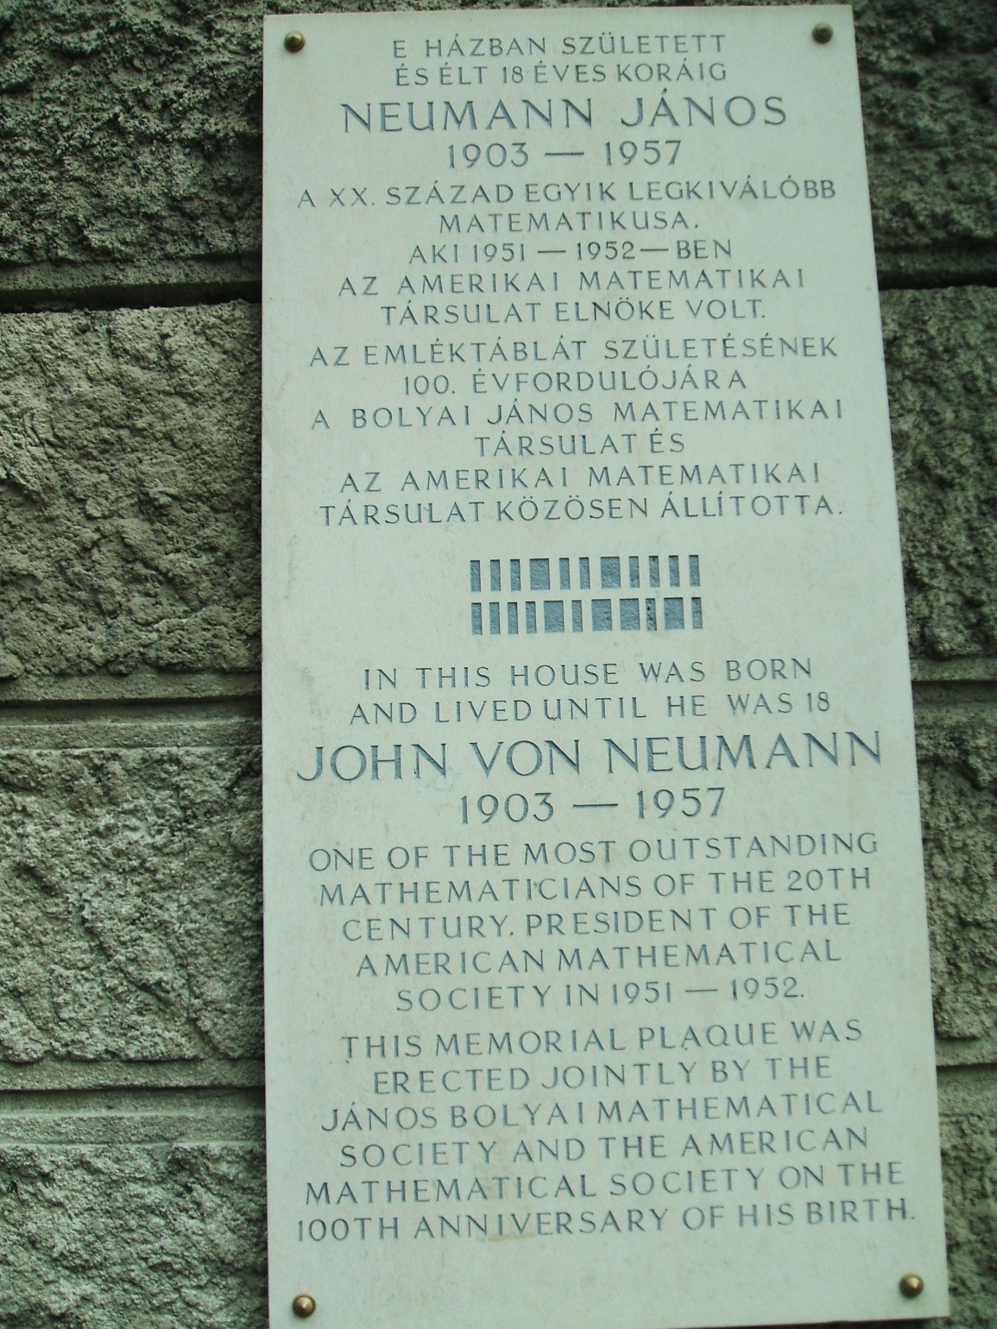
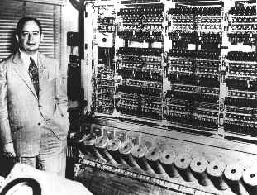
Birth house of
John von Neumann

Slide 4

Model ≠ reality

Slide 5
Engineers think model based
Model based thinking is the fundamental approach in engineering
Good engineering needs multi-aspect thinking and modeling

Slide 6
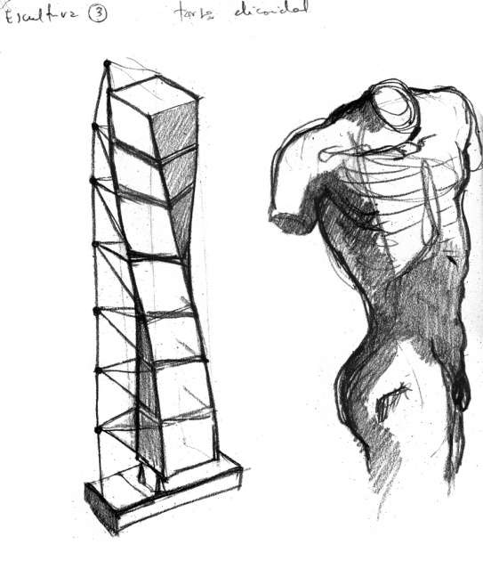
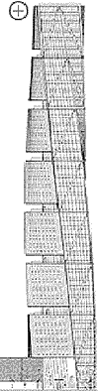

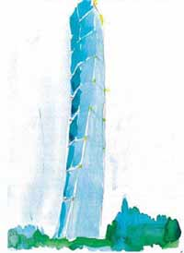
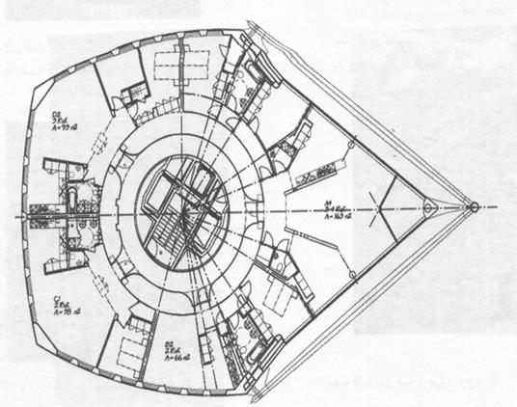
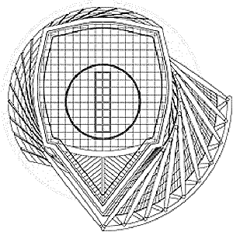
Models in a design workflow
Concept
Implementation
Operation
Specification
Structure

Slide 7
Conceptual design
Objective
Exploration of user needs
Basic concepts,
Fundamental requirements, constraints
  Avoidance of overspecification
Evaluation of alternatives
Modeling language
Maximal flexibility (user-designer interaction)
  Free-choice notions vs avoidance of ambiguity
Checks
  Rough conformance to the designated functionality
  Feasibility estimation of implementation
    Technology
    Constraints

Slide 8
Specification design
Objective
Precise formulation of user needs and basic concepts
  Functional spectrum
  Fitting to the environment
  Quantitative (metrics)
Extra-functional
  Throughput, energy…
  Safety (fire, earthquake), security (intrusion, sabotage)
Fundamental requirements, constraints
  Design space,
  Avoidance of over-specification
Modeling language
Flexible but precise (area=9000 m² nominal, useful?)
  Standards/aspects compliance
Checks
  Completeness and consistency
  Conformance: to functional and extra-functional standards or user requirements
  Feasibility of component implementation

Slide 9
Architecture/structure design
Objective
Component specification breakdown and integration concept
Component implementation technology selection
Extra-functional requirements
Modeling language
Flexible but precise
Compact models - DSL
Checks
  Multi-aspect
    Functional requirements
    Extra-functional
      robustness
  Feasibility of implementation in the design space

Slide 10
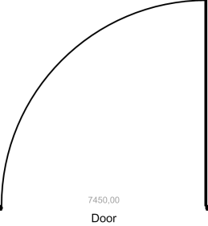
Implementation design
Objective
Precise formalization of the component
Fundamental requirements, constraints
  Component design space and technology
  Interfaces
  Avoidance of ambiguity
Extrafunctional requirements
Modeling language
Precise
Fitting to the implementation technology
Checks
  Component-level compliance to the designated functionality and extra-functional requirements
  Feasibility of implementation

Slide 11
Operation design
Objective
Check of the compliance to
  Fundamental requirements, constraints
  Extrafunctional requirements
Modeling language
Both structural and specification
Procedures
Similarities
Checks
  Compliance to the designated functionality and extra-functional requirements
  Planned reaction to violations (emergency plans)
  Facilitating reactions to unanticipated ones

Slide 12
Mda for critical systems
OMG promised a silver bullet with UML,
today we know, that it is not
MDA was designed with no extrafunctional properties in the mind
User comfort vs. precisity

Slide 13
Design for SecureThings
Measurement and extraction
Specification
Completeness consistency
Parameterization
Transformation
Optimization
Simulation
Design
modell
Partitioning
Verification
Scheduling
Communication
synthesis
Complexity?
Mobile, ad-hoc, large scale
Behavioral model
Hardware
synthesis
Software
synthesis
Incident/fault modelling
Implementation
V&V (formal/test)
Benchmarking, data processing

Slide 14
Modeling and matematics
Engineers think in engineering models

Slide 15
Workflow
Hierarchy
Monotic refinement
  Domain
  State
  Structure
Aggregation/refinement

Slide 16
Concepts – refinement
Refinement: enriching the model with details…
…but retaining the original model as abstraction
Inverse: (vertical) abstraction
On the previous slide: hierarchical refinement
  „opening the boxes”
Also refinable...
  e.g. Set refinement: variable valueset
    Instead of Good / bad
    Fast / average / slow / incomplete / dangerous
Notes:
hierarchikus finomítás
Miért is finomítunk?

Slide 17
Set refinement
Assign disjunct subsets to elements
∀a_{i}, ∈ A, R(a_{i}) ⊂ B , where R(a_{i}) ∩ R(a_{j})=∅ ∀i, j
a
B
1
a
1
a
2
B
3
2
B
3
Notes:
Lopott ábra ☺
Kérdés: ha van már finomított modellünk, akkor érvényét veszti az eredeti?

Slide 18
Concepts - Metamodeling
Modeling language: element types?
  …possible connections between elements?
  …how are the types related?
Metamodel = a model of a modeling language
Widely-known illustrations
  Entity-relation (ER) model
  UML object diagram → class diagram
  Database table → relational database schema
  XML document→ XML schema (or DTD)
  …
Neptun code
Room
Code
Average
enroll
Student
Course
Notes:
Modellezési nyelv pl. a modellvasút. Mi a metamodellje?
Eszetekbe jut-e még másfajta metamodell?
Rajzoljunk pl. UML class és object diagramokat az ER alapján!
A metamodell is modell, (a) finomítsuk, (b) készítsük el a metamodelljét!

Slide 19
Classification: formal vs. informal
How many mathematical formulae it contains?
  How much it constraints the modeled system?
Continuous scale, not separated clearly
  Mediumfluxuation described by differential equations
  State machine
  Sequence diagram
Strict is not always good
  Hard to insert mathematical formulae
  Expressive…
B
A
S
John
Jack
How much?
30!
30 what?
How much what?
Notes:
Navier-Stokes az összenyomható folyadékokra (by Wikipedia)
Milyen matematikai állításokat hordoz ez a szekvencia-diagram?
Melyik alapján érted meg jobban a rendszert, a szekvencia-diagram, vagy a differenciálegyenlet alapján?
(képzavar: nem ugyanaz a rendszer)

Slide 20
Mechanized approach
Design of an IT system
Mathematical analysis
Automated
model generation
(Semi-)formal
specification,
system
model
Mathematical
model
Analysis tool
Back-annotation
Code generation
Implementation

Slide 21
Model-Driven Development
A response for new system development challenges
  Uses standard modeling languages for specification
    High level
    (mostly) graphical
    Typically UML based
  Separates core functionalities from platform specific system components
    Multi-level modeling (PIM, Platform, PSM)
    Need for model transformations

Slide 22
Model-Driven Development
The “standard” Model Driven Architecture
Models
Models
Models
Transformations
Transformations

Slide 23
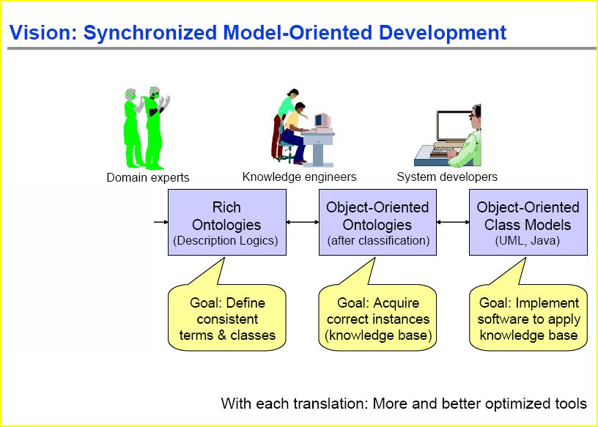
From ontologies to metamodels
H. Knublauch:
Ontology Design and Software Technology, Colloquium - Stanford Medical Informatics, 2003
Let define first
what we want to say
and only after
how to say it

Slide 24
Definition of concepts: ontologies
Design and analysis need clear concepts
What does it mean „fail silent”?
From where come elements into a metamodel?

Slide 25

Ontology
A data model that
represents a domain and
Has a logic in the background
is used to reason about
  the objects in that domain and
  the relations between them.
Ontologies generally describe:
Individuals:
basic objects
Classes:
sets, collections, or types of objects
Attributes:
properties, features… that objects can
have and share
Relations: ways that objects can be related
Reasoning :
Concept space traversal
  subsumption test wrt. different profiles
  consistency check: satisfiability
  circular containment of classes

Slide 26
ISO 24707:2007 Common logic
Standard:
Information technology — Common Logic (CL): a framework for a family of logic-based languages
Framework for a family of logic languages,
  based on first-order logic,
  Exchange of knowledge in IT systems.
Supports different syntactic forms (dialects).
  syntactic CL conformance of dialect -> CL semantics for free
  all CL dialects are equivalent
  mechanical translation

Slide 27
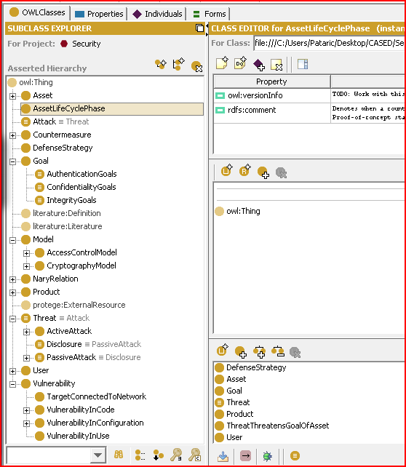
Example: part of the security ontology
Herzog et al:
An Ontology of Information Security
Int. J. of Inf. Security and Privacy (1), 4

Slide 28
Way to system/sw engineering metamodels
From concepts to graphical engineering languages

Slide 29
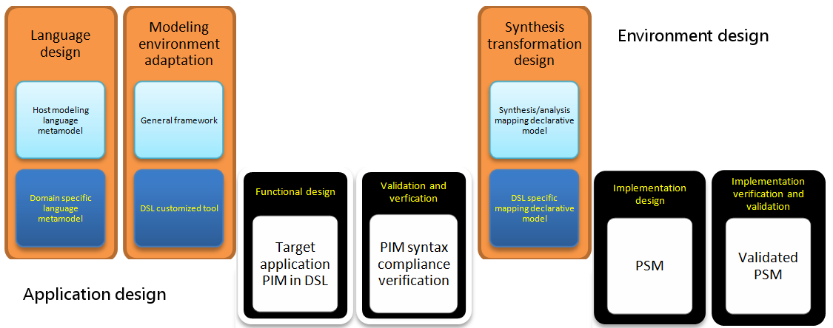
Metamodel
Automatic V&V of DSLs 29 of 34

Slide 30
Language specialization pyramide
DSL
SySML
UML
Domain specific notations
  „Native” language for the modeler
  Compact models
  Productivity ▲
  Design faults▼
  IP reusability ▲
IP reuse
  Standards
  Models
  Components
Existing IP
Components
Models
Automatic V&V of DSLs 30 of 34

Slide 31
Designing Modeling Languages
Metamodeling: Design methodology of modeling languages
Metamodel: model of a modeling language
Features:
  Concrete syntax
  Abstract syntax
  Well-formedness rules
  Semantics
  Mappings to other languages

Slide 32
Metamodels and model instances
Automaton
Generalization
Association
transitions
current
states
AccState
State
from
Transition
Class
Instantiation
color:{R,G,B}
to
Metamodel
Attribute
Meta (Language) level
Model level
Object
t3
fr
to
a1
s3
curr
t3
st
st
s1
a1
s3
s1
t2
tr
st
tr
fr
to
t1
s2
t1
s2
t2
Link
to
fr
Abstract syntax
Concrete syntax

Slide 33
PIM Metamodel
Interface
Port
Statevariable
Job
Message
Resource
Redundancy degree as a parameter
Dependable Application Subsystem

Slide 34
The language chain
Concept
Ontology
flexibility
Specification
Ontology
Concepts+relations
Structure
DSL
Multi-aspect
Implementation
Host language
UML+System modeling
Technology compliance
Operation
?
Fast execution
The gap between ontologies and metamodels get narrow
OMG Ontology Definition Metamodel –2009

Slide 35
Formal checks of (meta)models
Metamodel-metamodel (internal, external)
Metamodel-model
Requirement-model
UML
SySML
Technology design
DECOS
Applicaton design
Requirements
MODEL

Slide 36
V&V: use of reasoners
Metamodel level
  consistency check: inconsistent class (satisfiability check)
    no instances satisfying the class descriptions
    (e.g. multiplicity conflict)
  subsumption test: e.g. redundant concepts
  cycle detection: loop in the concept hierarcy
  uniqueness: e.g. redundant concepts
Model level
  Consistency check
    checks the conformance of the model to the metamodel
    consistency of the instance model wrt. the metamodel ontology
  Property check
    Reduction of technical problems to satisfyability check
    E.g. is there an instance violating security requirements?

Slide 37
MDD for Embedded Systems
Model Transformations
  Involving non-functional properties and constraints
    Timeliness (WCET, deadlines, periods)
    Dependability (replication, availability reqs.)
    …
  Iterative, interactive transformations
    Include user input and feedback (marking)
    User may include additional requirements
      Design decisions based on external constraints

Slide 38
MDD for Embedded Systems
Verification and Validation
  Continuous validation of system models
    Using ontology
  Formal analysis tools
    Model checking, Petri nets, etc.
  V-plan based V&V process
    (semi) automatic execution of V&V steps
  DSM-to-analysis transformations needed

Slide 39
An MDD tool chain

Slide 40
Tool Chain: Model-Based Integrated Development Support
"From Requirements To Deployment"
Requirements
  functional, performance, dependability
Cluster modelling
  nodes, network
Behaviour modelling
  of jobs
PIM-PSM mapping
  allocation and scheduling
Code generation
  Middleware
  Configuration
  Job code
Deployment
  compile, link, download
Verification & Validation (V&V)
  accompanying (Test Bench)

Slide 41
Model transformations

Slide 42
Model transformation – VIATRA2
Transformation technology
  Graph transformation rules
  Abstract state machines
Design environment
  Eclipse Framework
  Support for
    Developing, Debugging, Testing, and running model transformations
Runtime environment
  Independent transformation module
    Generated automatically

Slide 43
The VIATRA 2.0 framework
Eclipse framework
VIATRA 2.0 Model Transformation Plug-in
VPM Metamodeling Core
Source
metamodel
Xform. rules
(UML/QVT)
Target
metamodel
Source
model
Xform engine
(ASM+GraTra)
Target
model
Meta XForm
Transformation tool
Native
Source model
Native
XForm Plugin
Native
Target model

Slide 44
Graph transformation: typed components + interconnections
Next
:next
:Cell
:Cell
LHS+RHS (“reader”)
:val
:Int
:this
:this
LHS, not RHS (“eraser”)
:x
:x
RHS, not LHS (“creator”)
:Append
:Append
:control
:caller
:control
NAC (“embargo”)
:next
:next
:Cell
:Cell
:Cell
:Cell
:val
:Int
:Int
:this
:this
:this
:x
Next
:x
:x
:Append
:Append
:Append
:control
:caller
:control
+ control structures (ASM)

Slide 45
Example: allocation and scheduling

Slide 46
Current allocation and scheduling process
Three separate steps
  allocation (job-node)
  message scheduling
  Task scheduling
Results:
  if scheduling fails,
  backtrack
  cannot use global criteria
  for the steps
  only suboptimum can be
  reached

Slide 47
Opimization criteria
5 different selected
  Number of computing nodes used
  Throughput/overall delay of the system
  Extensibility (max. CPU time reserve)
  Extensibility (equal CPU time reserve)
  Robustness (minimum number of failing functions in case of hw faults)
Can be extended with new aspects

Slide 48
Absolute optimization
First feasible solution
(heuristics search, manual)

Slide 49
Tool GUI

Slide 50
Abstraction

Slide 51
Phases of monitoring
Event detection
Quantitative
Discrete
Event correlation
Separation of event flows
Event flow classification
Situation recognition
Temporal compaction
Logic correlation
Diagnosis

Slide 52
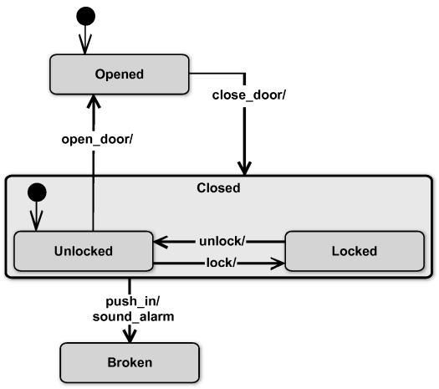
Phases of monitoring
Event detection
Quantitative
Discrete
Event correlation
Separation of event flows
Event flow classification
Situation recognition
Temporal compaction
Logic correlation
Diagnosis
Use cases
Misuse cases
Formalism
Statecharts
Sequence diagrams
Temporal logic

Slide 53
Phases of monitoring
Event detection
Quantitative
Discrete
Event correlation
Separation of event flows
Event flow classification
Situation recognition
Temporal compaction
Logic correlation
Diagnosis
Use cases
Misuse cases
Formalism
CSP
  Nominal
  Ordinal
representation
Normal
Broken

Slide 54
Application to the specification of error propagation PROPERTIES
Abstract models vs. derivation from engineering models
Formal methods have strict complexity limitations
  Efficient, but faithful abstractions are needed

Slide 55
Example for reduction: predicate abstraction
Full model:
IF credit_requested < 2.000.000 THEN approval(director)
ELSE approval(board)
Qualitative model with control flow preservation:
IF minor_credit_requested THEN approval(director)
ELSE approval(board)
Data domain: continuous
Qualitative abstraction:
  A few of qualitative values out of an enumerated data type set
  No detailed data representation
  Drastic state space (analysis complexity) reduction
  BUT: only semidecision
Domain after predicate abstraction: a binary value
Simple fault model: wrong branch selected

Slide 56
Predicate abstraction
Overabstraction for uniformization of the domains
1 representative for each operational domain

Slide 57
Core idea of qulitative modeling
High
Medium
Small
Medium
High
Small
Shape: stabilizing
Peak: High
Medium

Slide 58
Qualitative abstraction - spatial
Actual
Actual
Error
values
Spatial
compressor
Good
Faulty
Reference
Reference

Slide 59
Qualitative abstraction - error representation refinement
Actual
Actual
Out of range
Good
Spatial
compressor
Good
Minor
deviance
Out of range
Minor deviance
Major
deviance
Major
deviance
Reference
Reference

Slide 60
Temporal abstraction
Failure modes:
set of temporal logic expressions partitioning the event sequences
Syndrome: category indicator
  E.g. severity
  Most severe one in the sequence
Several compaction
scheme may exist
Arbirary LTL partitioning
of the sequence set

Slide 61
Qualitative component models
Dynamic by spatial abstraction:
error propagation automaton
  Same description paradigm, as the original one
  Same set of states
  Domain restricted to error modes
Static by subsequent temporal compaction:
error sensitivity combinations
  Input-output syndrome relations -> CSP
Common features
  Drastic complexity reduction (domain restricted to error modes)
  False alarms possible, but no dangerous case is lost
  Automated derivation from the functional model
Let’s do it in an OO and declarative way !

Slide 62
Fault model
  Input / output mapping → from risk model (?)
  Web service can be fault-free or faulty, it uses server1 as a resource.
web service | in | fty | r | out | diag
 | good | good | good | good | good
 | good | good | fty | fty | x
 | good | incons | good | 404 | 404
 | good | incons | fty | fty | x
 | fty | good | good | fty | x
 | fty | good | fty | fty | x
 | fty | incons | good | fty | x
 | fty | incons | fty | fty | x
 | x | good | good | x | x
 | x | good | fty | x | x
 | x | incons | good | x | x
 | x | incons | fty | x | x
Very detailed
„Microcoding” instead of proerty based derivation

Slide 63
System level fault impact analysis
Component 1
Component 2
Component 3
unprotected
Reconstructing
OUTPUT ERROR?
INPUT
ERROR
SYSTEM PROTECTION PROPERTIES
unprotected?
limiting ?
Function
Faults
Security properties
I/O behavior
Resource use
external
Internal
External
States
Stateful
Stateless
Protections
OO
CSP based description of properties

Slide 64
Metamodeling and qualitative abstraction
The principle can be
embedded
into any tool supporting
enumerated lists

Slide 65
Phases of monitoring
Event detection
Quantitative
Discrete
Event correlation
Separation of event flows
Event flow classification
Situation recognition
Temporal compaction
Logic correlation
Diagnosis
Use cases
Misuse cases
Formalism
Statecharts
Sequence diagrams
Temporal logic

Slide 66
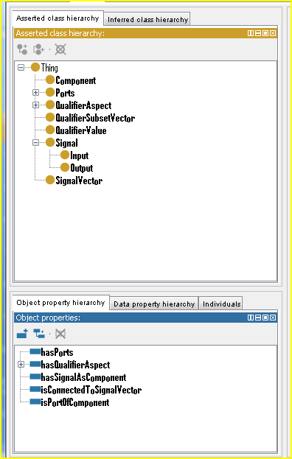
Top level: signal propagation graph
Basic notions
Component
Connection
Signal
Qualifier value

Slide 67
Model hierarchy
Design: top-down refinement
V&V: Counterexample driven refinement
Approximate analysis
Constraint C₁
Constraint C₂
Constraint C₃
Temporal
compaction
Temporal
compaction
Temporal
compaction
Temporal
compaction
Temporal
compaction
Qualitative C₁
Qualitative C₂
Qualitative C₃
Spatial
compaction
Spatial
compaction
Spatial
compaction
Spatial
compaction
Spatial
compaction
Full C₁
Full C₂
Full C₃

Slide 68



Cost impact
Req. anal.
Design
Implem.
Effort (PM)
100%
42%
11%
MDA
7%
MDA

Slide 69
Fault introduction and detection
Requirement analysis
Fault introduction
Fault escape probability
Design
Implementation
100%
0,3
0,3
0,07
57%
0,3
0,3
0,07
MDA
18%
0,3
0,3
0,07
MDA
11,5%
0,07
0,03

Slide 70
Quality improvement
11
6
2.5
0.25

