Slide 1
Synthetic CDOs and the Gaussian Copula
Almási Gábor Gabor.Almasi@msci.com
October 12, 2021

Slide 2
Agenda
What are Synthetic CDOs?
Development of the synthetic CDO market
Gaussian Copula: a simple way of modeling SCDOs
Click to add footnotes or disclosures.

Slide 3
What are Synthetic CDOs?

Slide 4
Classification
Synthetic CDOs are derivatives
Their cashflows are linked to the performance of an underlying asset or benchmark
Synthetic CDOs are credit derivatives
Their value links to the credit worthiness of one or more reference entities
A credit derivatives product
Gives protection to one side against default (bankruptcy / non-payment) of a ref. entity
Gives a steady cashflow to the other side for taking over some risk

Slide 5
Why trade credit derivatives?
Protection against default
Cheap exposure to credit
Hedge for global downturn
Speculation
Arbitrage (e.g. basis trading)
Any corp.
CDS
Financial
CDX
Client base
Asset manager
CDXO
Sophistication of client
Hedge fund
SCDO
Hedge fund
all

Slide 6
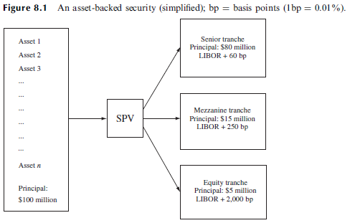
Securitization
Securitization originally (1960s): Portfolios of mortgages were created and the cash flows generated by the portfolios were packaged as securities → MBS (mortgage-backed security)
Later: extend machinery for automobile loans, credit card loans etc. → ABS (asset-backed security)
Small risk, easy to sell
Medium risk, Not so easy to sell
High risk, Kept or sold to hedge fund
Source: Hull – Options, Futures, and Other Derivatives

Slide 7
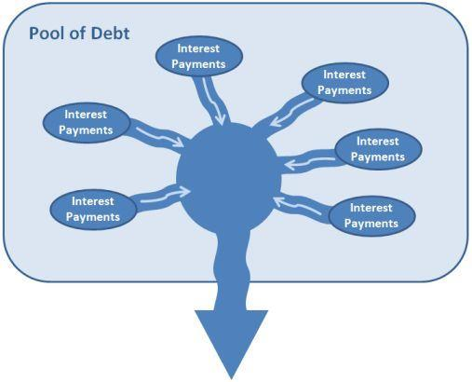
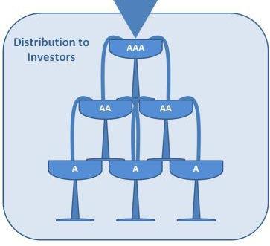
Cash-flow waterfall
Input:
Mortgages
Loans
Automobile
Credit card
Student loan
Output:
Senior tranche
Mezzanine tranche
…
Equity tranche
Source: https://economicdarwinism.wordpress.com/2009/03/28/letter-to-obama-our-voices-will-be-heard/

Slide 8
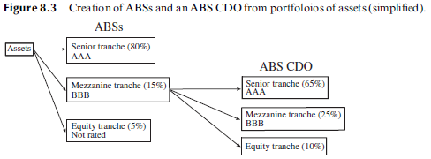
CDO: collateralized debt obligation
ABS mezzanine tranche is hard to sell, why not sell it again?
We can create AAA rated assets from BBB rated assets!
Same way we can also use bonds as underlying, or even other CDO tranches.
Source: Hull – Options, Futures, and Other Derivatives

Slide 9
Synthetic CDO (SCDO)
We don’t even need any loans / mortgages / bonds, why not just replicate cashflows with credit default swaps (CDS)
CDS
CDS
CDS
CDS
First SCDO by Goldman Sachs, Abacus 2004-1 had underlying CDS referencing
Residential MBS
Existing CDOs
Commercial MBS
In the present, most of SCDO baskets contain the most liquid corporate CDS contracts, usually based on credit indexes

Slide 10
The Synthetic CDO market

Slide 11
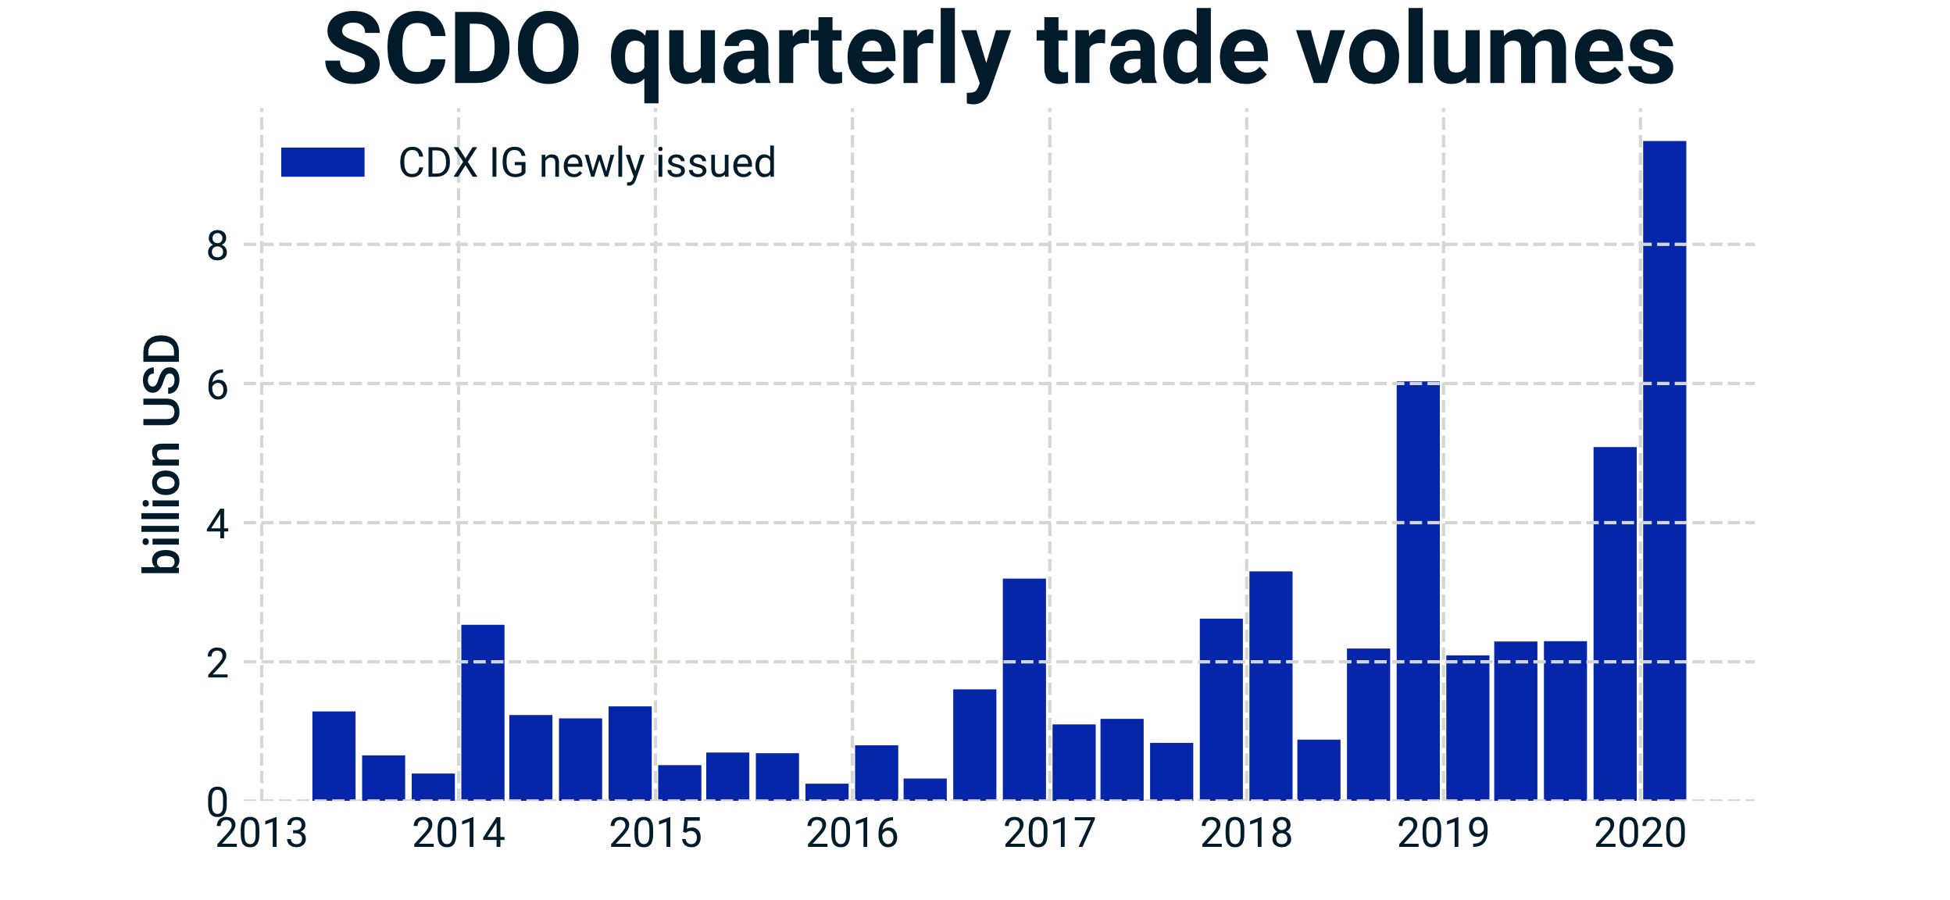
Hunt for yield: Synthetic CDOs Are Back
“Investors flock back to credit product blamed in financial crisis” FT, May 2019
Investors are pouring money into so called “bespoke tranches”
FT, November 2017
Data source: DTCC

Slide 12
The Past and Present of Synthetic CDOs
Abacus 2004-1 (Goldman Sachs)
CDX NA HY Series 33 (IHS Markit)
Underlying names:
Residential MBSs
Existing CDOs
Commercial MBSs
Linked to opaque, illiquid mortgage baskets
Default probabilities are hard to estimate, let alone default correlation
Exposure to the mortgage market only
Underlying names:
Most liquid corporate credit default swaps
Linked to to highly liquid USD /EUR corporates
Default probabilities are daily quoted and readily known
Exposure to all sectors of the economy

Slide 13
What’s in the basket?
Most Synthetic CDO transactions are based on major corporate credit indexes
Bespoke tranches have a share of around 10%
Data source: DTCC
Aggregated for all available SCDO transactions since 2014

Slide 14
Modeling Synthetic CDOs I.
CDS pricing and obtaining default probabilities

Slide 15
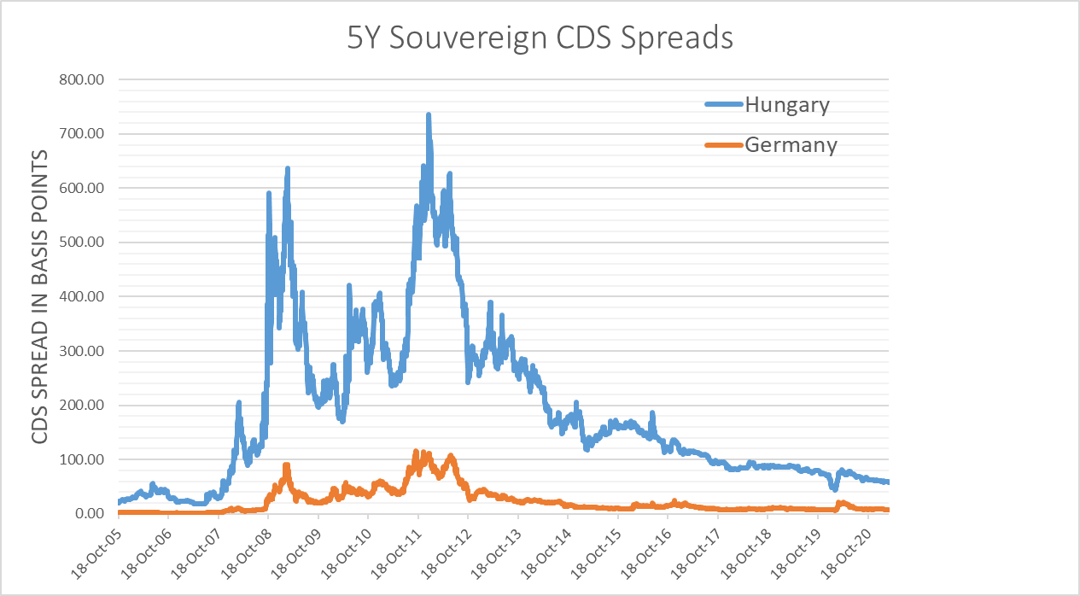
CDS spreads: measure of default risk

Slide 16
CDS modeling workflow
Obtaining CDS spreads
Determination of default intensities and probabilities
Asset pricing + further analysis
Click to add footnotes or disclosures.

Slide 17
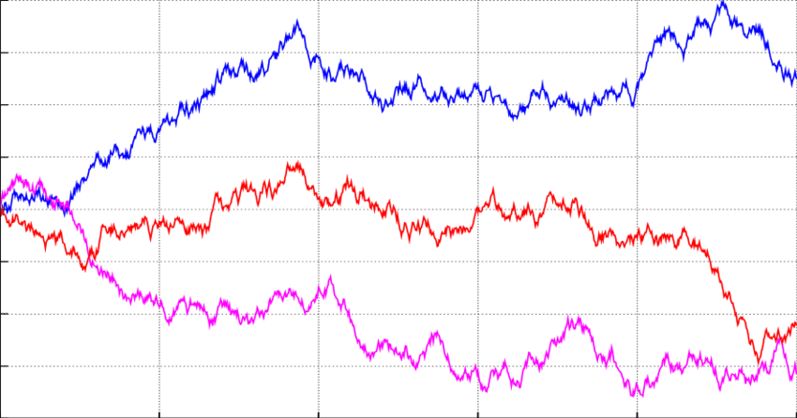
Obtaining CDS spreads
Through market data
Through modeling
Past market movements
Empirical predictions
Simulated trajectories (assuming a certain dynamics, e.g., GBM)
Click to add footnotes or disclosures.

Slide 18
Modeling default probabilities
Notation
$τ$: Time of default
Default indicator:
Default probability up to time $T$, assuming there was no default up to time $t$:
$$F\left(t, T\right)= 𝔼_{t}\left[𝟙_{\left\{τ≤T\right\}}| τ>t\right]$$
Since $F\left(t,t\right)=0$, and $F(t,T)$ is strictly increasing, furthermore $F\left(t,T\right)≤1,$ we can express F with a default intensity or hazard rate h(s) :
$$1 −F\left(t, T\right)=\exp\left(−\int_{t}^{T}{h\left(s\right)ds}\right)≔Q\left(t,T\right)$$
$$𝟙_{\left\{τ≤t\right\}}=\left\{\begin{aligned}1 if there is a default up to time t, \\ 0 otherwise \end{aligned}\right.$$
Click to add footnotes or disclosures.

Slide 19
Calibrating hazard rates
Assumed hazard rate curve
CDS spread data
$$S_{C}$$
$$h_{3}$$
Pricing
$$S_{B}$$
$$h_{2}$$
$$S_{A}$$
$$h_{1}$$
$$t_{A}$$
$$t_{B}$$
$$t_{M}$$
$$t_{C}$$
$$t_{A}$$
$$t_{B}$$
$$t_{M}$$
$$t_{C}$$
Comparison with market data
Click to add footnotes or disclosures.

Slide 20
Pricing a CDS contract in practice
Present value of a unit payoff
“Loss Given Default”
$$D\left(t,t_{i}\right)$$
$$LGD$$
Default leg
source | scheduledDate | termToPayment | discount rate | discountAtTerm | F(t) | paymentProbabilityAtTerm F(t)-F(t-1) | scheduledPayment | expectedPresentValue
Default Loss | 20/09/2012 | 0.002739726 | 0.162% | 0.999995556 | 1.38527E-05 | 1.38527E-05 | 0.600000000 | 0.000008312
Default Loss | 20/12/2012 | 0.252054795 | 0.370% | 0.999066811 | 0.001273647 | 0.001259794 | 0.600000000 | 0.000755171
Default Loss | 20/03/2013 | 0.498630137 | 0.356% | 0.998226997 | 0.002518035 | 0.001244389 | 0.600000000 | 0.000745310
Default Loss | 20/06/2013 | 0.750684932 | 0.354% | 0.997346075 | 0.003788475 | 0.001270439 | 0.600000000 | 0.000760241
Default Loss | 20/09/2013 | 1.002739726 | 0.357% | 0.99642848 | 0.00635313 | 0.002564655 | 0.600000000 | 0.001533297
Default Loss | 20/12/2013 | 1.252054795 | 0.361% | 0.995494447 | 0.008883413 | 0.002530283 | 0.600000000 | 0.001511330
Default Loss | 20/03/2014 | 1.498630137 | 0.367% | 0.994508244 | 0.01411077 | 0.005227356 | 0.600000000 | 0.003119189
Default Loss | 20/06/2014 | 1.750684932 | 0.376% | 0.993437509 | 0.019425795 | 0.005315025 | 0.600000000 | 0.003168087
Default Loss | 20/09/2014 | 2.002739726 | 0.388% | 0.99225346 | 0.024712166 | 0.005286371 | 0.600000000 | 0.003147252
Premium leg
source | scheduledDate | termToPayment | discount rate | discountAtTerm | F(t) | PV01 segments | scheduledPayment | expectedPresentValue
Premium | 20/06/2012 | -0.249315068
Premium | 20/09/2012 | 0.002739726 | 0.162% | 0.999995556 | 1.38527E-05 | 0.252774276 | -0.01 | -0.002527732
Premium | 20/09/2012 | 0.002739726 | 0.162% | 0.999995556 | 1.38527E-05 | 0.002777759 | -0.01 | -2.77775E-05
Premium | 20/12/2012 | 0.252054795 | 0.370% | 0.999066811 | 0.001273647 | 0.252615019 | -0.01 | -0.002523793
Premium | 20/03/2013 | 0.498630137 | 0.356% | 0.998226997 | 0.002518035 | 0.249526007 | -0.01 | -0.002490836
Premium | 20/06/2013 | 0.750684932 | 0.354% | 0.997346075 | 0.003788475 | 0.254749689 | -0.01 | -0.002540736
Premium | 20/09/2013 | 1.002739726 | 0.357% | 0.99642848 | 0.00635313 | 0.254259543 | -0.01 | -0.002533515
Premium | 20/12/2013 | 1.252054795 | 0.361% | 0.995494447 | 0.008883413 | 0.250851912 | -0.01 | -0.002497217
Premium | 20/03/2014 | 1.498630137 | 0.367% | 0.994508244 | 0.01411077 | 0.247125151 | -0.01 | -0.00245768
Premium | 20/06/2014 | 1.750684932 | 0.376% | 0.993437509 | 0.019425795 | 0.251269716 | -0.01 | -0.002496208
Premium | 20/09/2014 | 2.002739726 | 0.388% | 0.99225346 | 0.024712166 | 0.249915097 | -0.01 | -0.002479791
Default prob. up to a certain time
$$F\left({t,t}_{i}\right)$$
“Coupon”
$$C$$
$$PV=LGD×\sum_{i=1}^{n}{D\left(t,t_{i}\right)\left(F\left({t,t}_{i}\right)−F\left({t,t}_{i−1}\right)\right)}−C×\sum_{i=1}^{n}{D\left(t,t_{i}\right)\left(1−F\left(t,t_{i}\right)\right)}$$
Click to add footnotes or disclosures.

Slide 21
Modeling Synthetic CDOs II.
The Gaussian copula

Slide 22
SCDO mechanics - Understanding the waterfall
Senior tranche: 30-70%
Underlying basket (CDS contracts)
Comcast Corp.
The Home Depot, Inc.
Notional: 70
Loss: 0
Notional: 55
Loss: 0
Notional: 60
Loss: 0
American Express Comp.
Notional: 66
Loss: 0
Walmart Inc.
Nordstrom Inc.
Caterpillar Inc.
Macy’s, Inc.
Mezzanine tranche: 10-30%
Kinder Morgan, Inc.
Notional: 15
Loss: 5
The Walt Disney Comp.
Notional: 20
Loss: 0
Conagra Brands, Inc.
Notional: 70
Loss: 15
Equity tranche: 0-10%
Notional: 90
Loss: 6
Notional: 100
Loss: 0
Notional: 80
Loss: 10
Notional: 10
Loss: 0
Notional: 4
Loss: 6
Notional: 0
Loss: 10

Slide 23
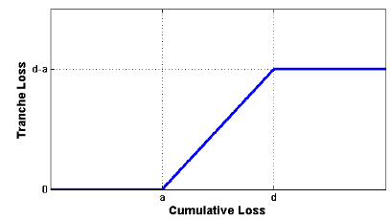
Nonlinear payoff – correlation matters
Tranche loss is
Zero if the attachment point is not reached
Linear as a function the cumulative loss between the attachment and detachment points
Flat after the detachment point is hit
Nonlinear tranche loss – cumulative loss function: for pricing we need to know the distribution of the losses over scenarios, the expected cumulative loss is not sufficient
Default correlation is a key risk factor
Notes:
TODO: format

Slide 24
Why the loss distribution matters (and not just the expected loss)
Senior
Mezzanine
Equity
No default correlation
Better for mezzanine tranche, worse for equity
High default correlation
Better for equity tranche, worse for mezzanine

Slide 25
Simulation of losses – no correlation
How can we simulate future losses with appropriate default probabilities?
MC simulation
Input: CDS default probabilities up to time $t$: $π_{i}\left(t\right)$
$X_{i}$: identical independent normally distributed variables
$Φ$: normal distribution cumulative distribution function
Condition of default in a simulated scenario:
$$X_{i}≤k_{i}\left(t\right)≔Φ^{−1}(π_{i}\left(t\right))$$
Probability of default (consistency check):
$$P\left({\text{τ}}_{i}≤t\right)=P\left(X_{i}≤k_{i}\left(t\right)\right)=Φ\left(k_{i}\left(t\right)\right)=π_{i}\left(t\right)$$
Missing: market turmoil, global crises
We need correlation between defaults!

Slide 26
One factor Gaussian copula
MC simulation
Input: CDS default probabilities up to time $t$: $π_{i}\left(t\right)$
$X_{i}, Z$: identical independent normally distributed variables
$Φ$: normal distribution cumulative distribution function
Condition of default in a simulated scenario:
$$X_{i}=ωZ+\sqrt{1−ω^{2}}ε_{i}≤k_{i}\left(t\right)≔Φ^{−1}(π_{i}\left(t\right))$$
Conditional probability of default:
$$P\left({\text{τ}}_{i}≤t | Z\right)=P\left(X_{i}≤k_{i}(t) | Z\right)=Φ\left(\frac{k_{i}\left(t\right)−ωZ}{\sqrt{1−ω^{2}}}\right)≔π_{i}\left(t|Z\right)$$
$Z$has an effect on all the default probabilities
$ω$: determines the amount of correlation

Slide 27
CDO Loss Distribution in the Large Pool Approx.
Defaults are only correlated through $Z$: once $Z$ is fixed, default events are uncorrelated
All K conditional default probabilities are identical: $π\left(t|Z\right)$
All loss amounts are identical: $\left(1−R\right)$: number of defaults determines the total loss
Number of defaults follow Binomial distribution
This is the distribution of the defaulted constituent numbers
Granular approach: more involved methods are needed
$$P_{d}\left(k,t | Z\right)=\left(\begin{aligned}K \\ k\end{aligned}\right)⋅π{\left(t|Z\right)}^{k}⋅{\left(1−π\left(t|Z\right)\right)}^{K−k}$$
$$P_{d}\left(k,t\right)=\int_{−∞}^{∞}{P_{d}\left(k,t | Z\right)f\left(Z\right)dZ} =\frac{1}{\sqrt{2π}}\int_{−∞}^{∞}{P_{d}} \left(k,t | Z\right)\exp{(−Z^{2}/2)}dZ$$

Slide 28
Appendix
Extensions of the Gaussian copula

Slide 29
Limitations of the Gaussian copula
During the financial crisis senior tranche prices went up
Standard Gaussian copula fails to produce enough extreme scenarios
Solution: couple recovery rates to the market factor as well
Stochastic Recovery Model

Slide 30
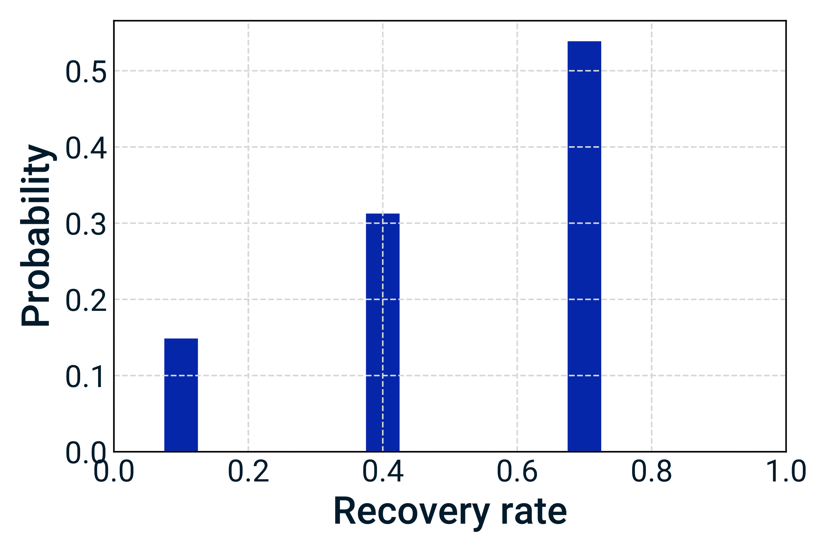
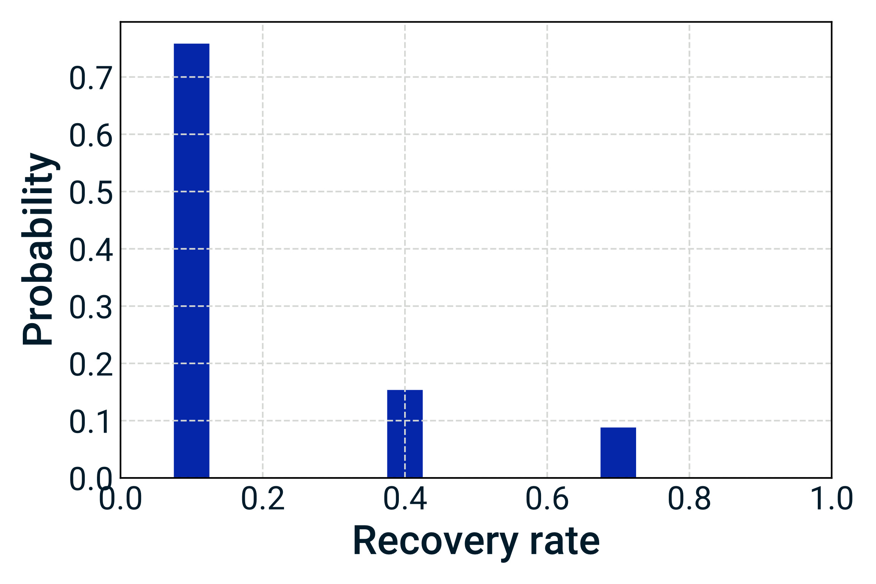
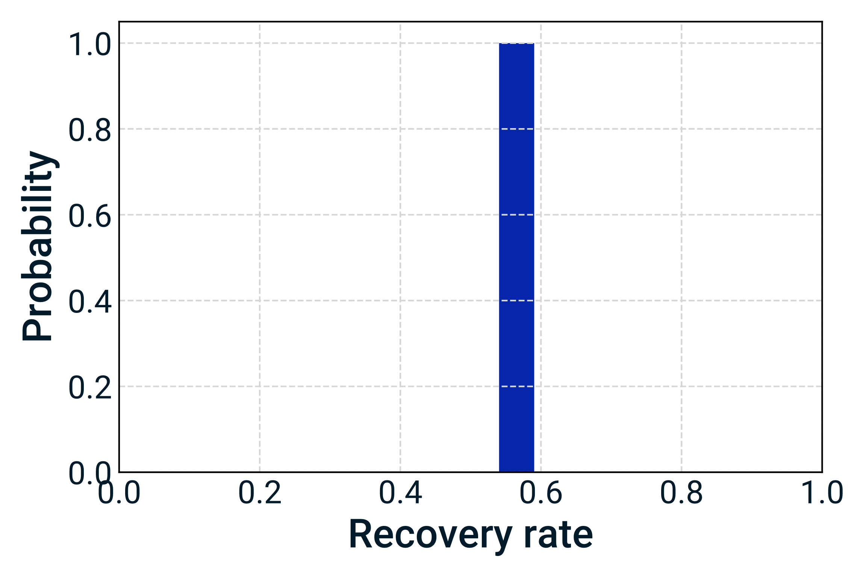
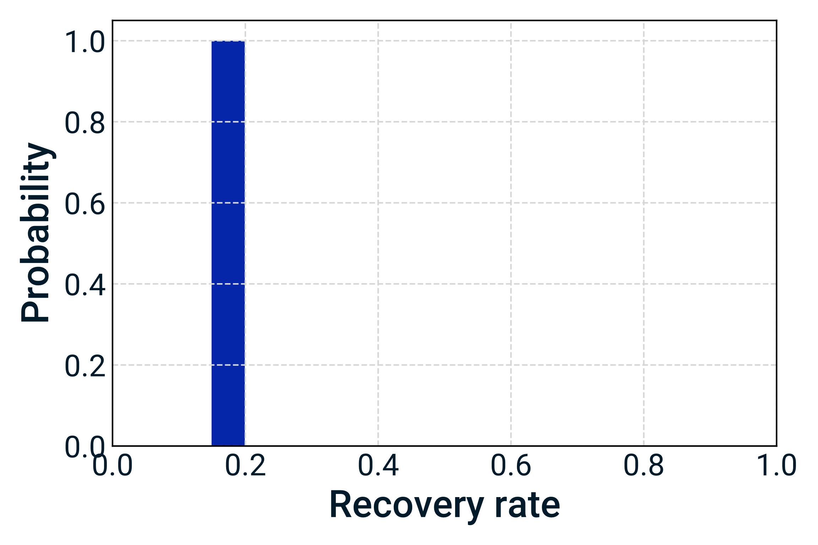
Stochastic recovery modeling
Normal market
Crisis
Model A
Model B

Slide 31
About MSCI
MSCI is a leading provider of critical decision support tools and services for the global investment community. With over 45 years of expertise in research, data and technology, we power better investment decisions by enabling clients to understand and analyze key drivers of risk and return and confidently build more effective portfolios. We create industry-leading research-enhanced solutions that clients use to gain insight into and improve transparency across the investment process. To learn more, please visit www.msci.com.

Slide 32
Contact us
AMERICAS | EUROPE, MIDDLE EAST & AFRICA | ASIA PACIFIC
Americas +1 888 588 4567 * | Cape Town + 27 21 673 0100 | China North 10800 852 1032 *
Atlanta + 1 404 551 3212 | Frankfurt + 49 69 133 859 00 | China South 10800 152 1032 *
Boston + 1 617 532 0920 | Geneva + 41 22 817 9777 | Hong Kong + 852 2844 9333
Chicago + 1 312 675 0545 | London + 44 20 7618 2222 | Mumbai + 91 22 6784 9160
Monterrey + 52 81 1253 4020 | Milan + 39 02 5849 0415 | Seoul 00798 8521 3392 *
New York + 1 212 804 3901 | Paris 0800 91 59 17 * | Singapore 800 852 3749 *
San Francisco + 1 415 836 8800 |  | Sydney + 61 2 9033 9333
São Paulo + 55 11 3706 1360 |  | Taipei 008 0112 7513 *
Toronto + 1 416 628 1007 |  | Thailand 0018 0015 6207 7181 *
 |  | Tokyo +81 3 5290 1555
= toll free msci.com clientservice@msci.com

Slide 33
Notice & disclaimer
This document and all of the information contained in it, including without limitation all text, data, graphs, charts (collectively, the “Information”) is the property of MSCI Inc. or its subsidiaries (collectively, “MSCI”), or MSCI’s licensors, direct or indirect suppliers or any third party involved in making or compiling any Information (collectively, with MSCI, the “Information Providers”) and is provided for informational purposes only. The Information may not be modified, reverse-engineered, reproduced or redisseminated in whole or in part without prior written permission from MSCI.
The Information may not be used to create derivative works or to verify or correct other data or information. For example (but without limitation), the Information may not be used to create indexes, databases, risk models, analytics, software, or in connection with the issuing, offering, sponsoring, managing or marketing of any securities, portfolios, financial products or other investment vehicles utilizing or based on, linked to, tracking or otherwise derived from the Information or any other MSCI data, information, products or services.
The user of the Information assumes the entire risk of any use it may make or permit to be made of the Information. NONE OF THE INFORMATION PROVIDERS MAKES ANY EXPRESS OR IMPLIED WARRANTIES OR REPRESENTATIONS WITH RESPECT TO THE INFORMATION (OR THE RESULTS TO BE OBTAINED BY THE USE THEREOF), AND TO THE MAXIMUM EXTENT PERMITTED BY APPLICABLE LAW, EACH INFORMATION PROVIDER EXPRESSLY DISCLAIMS ALL IMPLIED WARRANTIES (INCLUDING, WITHOUT LIMITATION, ANY IMPLIED WARRANTIES OF ORIGINALITY, ACCURACY, TIMELINESS, NON-INFRINGEMENT, COMPLETENESS, MERCHANTABILITY AND FITNESS FOR A PARTICULAR PURPOSE) WITH RESPECT TO ANY OF THE INFORMATION.
Without limiting any of the foregoing and to the maximum extent permitted by applicable law, in no event shall any Information Provider have any liability regarding any of the Information for any direct, indirect, special, punitive, consequential (including lost profits) or any other damages even if notified of the possibility of such damages. The foregoing shall not exclude or limit any liability that may not by applicable law be excluded or limited, including without limitation (as applicable), any liability for death or personal injury to the extent that such injury results from the negligence or willful default of itself, its servants, agents or sub-contractors.
Information containing any historical information, data or analysis should not be taken as an indication or guarantee of any future performance, analysis, forecast or prediction. Past performance does not guarantee future results.
The Information should not be relied on and is not a substitute for the skill, judgment and experience of the user, its management, employees, advisors and/or clients when making investment and other business decisions. All Information is impersonal and not tailored to the needs of any person, entity or group of persons.
None of the Information constitutes an offer to sell (or a solicitation of an offer to buy), any security, financial product or other investment vehicle or any trading strategy.
It is not possible to invest directly in an index. Exposure to an asset class or trading strategy or other category represented by an index is only available through third party investable instruments (if any) based on that index. MSCI does not issue, sponsor, endorse, market, offer, review or otherwise express any opinion regarding any fund, ETF, derivative or other security, investment, financial product or trading strategy that is based on, linked to or seeks to provide an investment return related to the performance of any MSCI index (collectively, “Index Linked Investments”). MSCI makes no assurance that any Index Linked Investments will accurately track index performance or provide positive investment returns. MSCI Inc. is not an investment adviser or fiduciary and MSCI makes no representation regarding the advisability of investing in any Index Linked Investments.
Index returns do not represent the results of actual trading of investible assets/securities. MSCI maintains and calculates indexes, but does not manage actual assets. Index returns do not reflect payment of any sales charges or fees an investor may pay to purchase the securities underlying the index or Index Linked Investments. The imposition of these fees and charges would cause the performance of an Index Linked Investment to be different than the MSCI index performance.
The Information may contain back tested data. Back-tested performance is not actual performance, but is hypothetical. There are frequently material differences between back tested performance results and actual results subsequently achieved by any investment strategy.
Constituents of MSCI equity indexes are listed companies, which are included in or excluded from the indexes according to the application of the relevant index methodologies. Accordingly, constituents in MSCI equity indexes may include MSCI Inc., clients of MSCI or suppliers to MSCI. Inclusion of a security within an MSCI index is not a recommendation by MSCI to buy, sell, or hold such security, nor is it considered to be investment advice.
Data and information produced by various affiliates of MSCI Inc., including MSCI ESG Research LLC and Barra LLC, may be used in calculating certain MSCI indexes. More information can be found in the relevant index methodologies on www.msci.com.
MSCI receives compensation in connection with licensing its indexes to third parties. MSCI Inc.’s revenue includes fees based on assets in Index Linked Investments. Information can be found in MSCI Inc.’s company filings on the Investor Relations section of www.msci.com.
MSCI ESG Research LLC is a Registered Investment Adviser under the Investment Advisers Act of 1940 and a subsidiary of MSCI Inc. Except with respect to any applicable products or services from MSCI ESG Research, neither MSCI nor any of its products or services recommends, endorses, approves or otherwise expresses any opinion regarding any issuer, securities, financial products or instruments or trading strategies and MSCI’s products or services are not intended to constitute investment advice or a recommendation to make (or refrain from making) any kind of investment decision and may not be relied on as such. Issuers mentioned or included in any MSCI ESG Research materials may include MSCI Inc., clients of MSCI or suppliers to MSCI, and may also purchase research or other products or services from MSCI ESG Research. MSCI ESG Research materials, including materials utilized in any MSCI ESG Indexes or other products, have not been submitted to, nor received approval from, the United States Securities and Exchange Commission or any other regulatory body.
Any use of or access to products, services or information of MSCI requires a license from MSCI. MSCI, Barra, RiskMetrics, IPD and other MSCI brands and product names are the trademarks, service marks, or registered trademarks of MSCI or its subsidiaries in the United States and other jurisdictions. The Global Industry Classification Standard (GICS) was developed by and is the exclusive property of MSCI and Standard & Poor’s. “Global Industry Classification Standard (GICS)” is a service mark of MSCI and Standard & Poor’s.
MIFID2/MIFIR notice: MSCI ESG Research LLC does not distribute or act as an intermediary for financial instruments or structured deposits, nor does it deal on its own account, provide execution services for others or manage client accounts. No MSCI ESG Research product or service supports, promotes or is intended to support or promote any such activity. MSCI ESG Research is an independent provider of ESG data, reports and ratings based on published methodologies and available to clients on a subscription basis. We do not provide custom or one-off ratings or recommendations of securities or other financial instruments upon request.
Privacy notice: For information about how MSCI ESG Research LLC collects and uses personal data concerning officers and directors, please refer to our Privacy Notice at https://www.msci.com/privacy-pledge.

