Slide 1
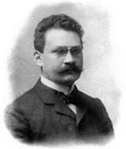
Space-time or Time-space Ákos G.Horváth
In memory of Hermann Minkowski
Alfréd Rényi Institute of Mathematics, 06. Dec. 2013

Slide 2
References

Slide 3
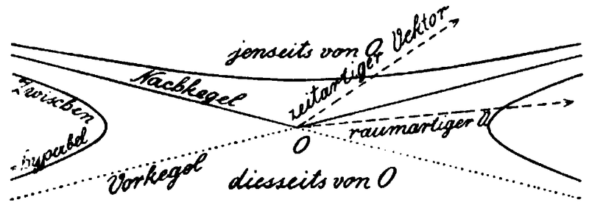
The Minkowski space-time

Slide 4
Unit spheres in space-time

Slide 5
Semi-indefinite inner product

Slide 6
Minkowski product

Slide 7
Generalized space-time model

Slide 8
Prehyperbolic space

Slide 9
Presphere

Slide 10
Light cone

Slide 11
The unit sphere of the embedding s.i.p. space

Slide 12
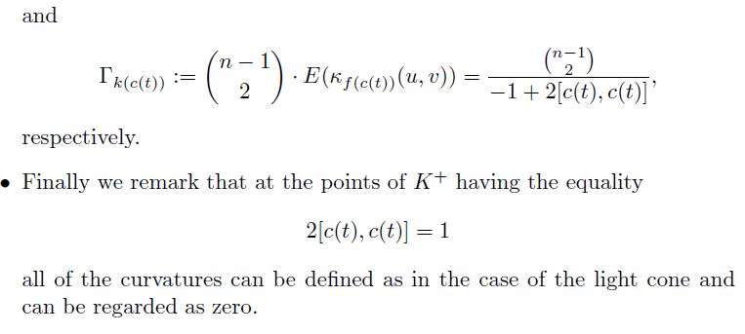

Slide 13
Changing shape

Slide 14
Deterministic time-space model

Slide 15
Random time-space model

Slide 16
The probability measure P (I)

Slide 17
The probability measure P (II)

Slide 18
The probability measure P (III)

Slide 19
The probability measure P (IV)

Slide 20
The probability measure P (V)

Slide 21
The probability measure P (VI)

Slide 22
Fundamental theorem on approximation

Slide 23
The product in a deterministic time-space

Slide 24
Differentiability of the second argument (I)

Slide 25
Differentiability of the second argument (II)

Slide 26
Imaginary unit sphere

Slide 27
The de Sitter sphere

Slide 28
The shape function and frames

Slide 29
On the formulas of special relativity

Slide 30
General relativity theory (embedded metrics)

Slide 31
General relativity theory (visualization)

